Slide 1
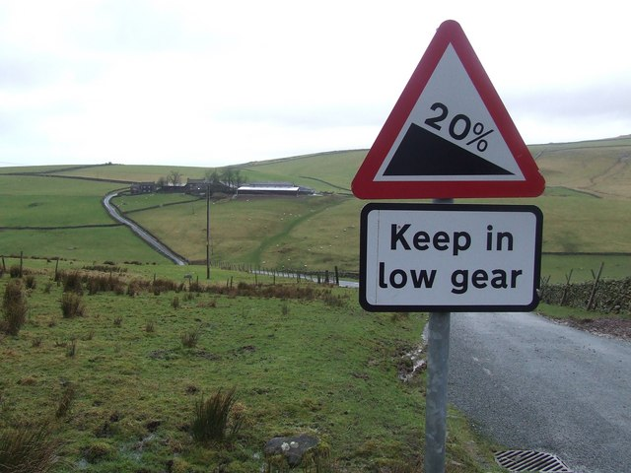
Straight Line Graphs
Revision session:
How to draw a line
Using y = mx + c
Parallel lines
Notes:
Briefly introduce the session and explain what we hope to cover. If the group progress well, they should have the opportunity to try some questions involving parallel lines, and there will be extension material on perpendicular lines for any who are already familiar with this.

Slide 2
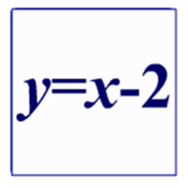
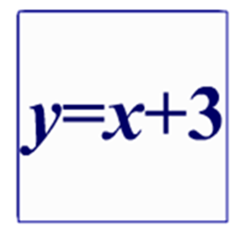
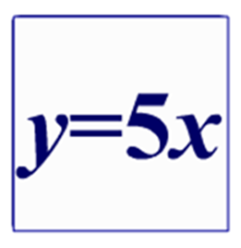
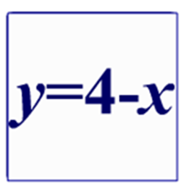
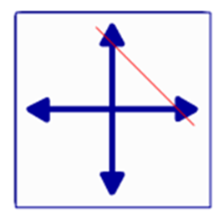
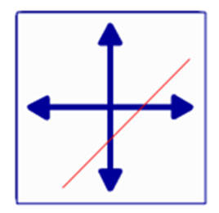
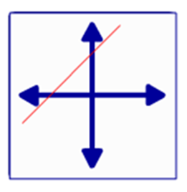
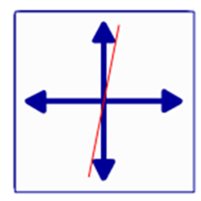
Match the equations to the graphs
A)
B)
C)
D)
2)
3)
4)
1)
Notes:
Students will have these on their desks when they come in. This will act as a mini-AFL task to enable me to assess the level of the group.

Slide 3
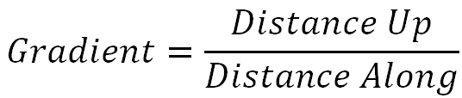
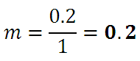
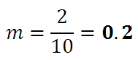
Gradient is the steepness of a line
2
0.2
1
10
Notes:
Discuss briefly the concept of gradient as steepness, and discuss the meaning of a 20% grade on a hill.

Slide 4
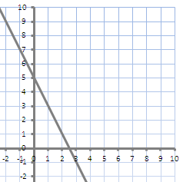
y = mx + c
y-intercept
gradient
y = -2x + 5
Notes:
Key concept is y=mx+c, but should also point out the negative gradient (along 1 and down 2). After this, will go to Grapher spreadsheet to demonstrate how to draw a line from a table of values.

Slide 5
Drawing lines
Draw the line: y = 3x – 2
If you finish quickly: y = 3x + 6
How?
Make a table of values
OR
Mark the intercept, then move
along 1 and up m to find more points
Notes:
Students may plot graphs in whatever way they have learnt, although hopefully some who might have stuck with T of V before may try the quick method. This will also have been pointed out on Grapher. Once all have drawn one line (and some may have drawn both), show the lines on Grapher spreadsheet and highlight the fact that their slopes are the same. Same gradient = parallel.

Slide 6
GCSE Exam Question – Straight Line Graphs
y = ½x + ?
y = ?x + 1
Remember:
Parallel lines have the same gradient
Notes:
Give students the first exam question. It tests understanding of gradient and intercept. A parallel line has the same gradient but could have any intercept, and a line passing through (0,1) has the same intercept but may have any gradient.

Slide 7
Choose which questions to work on
based on where you think you are.
Using a table
of values & matching equations to graphs.
Dealing with perpendicular lines.
Dealing with parallel lines.
Yellow Sheet
Red Sheet
White Sheet
Notes:
Students are now given a choice. Since this is a revision session and the ability and confidence with the different aspects may vary considerably, there are different levels of sheets. Beginner sheets (white) focus on the basic skills of drawing a graph, moving on to identifying equations from drawn lines. Yellow sheets are for more confident students who have grasped the key ideas but want more practice looking at parallel lines. Red are for people for whom the rest has just been a recap and need something more advanced to tackle. They involve perpendicular lines which, if necessary, I can discuss with individuals depending on time. May also be demonstrated using Grapher.

Slide 8
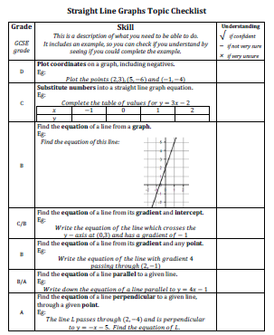
Straight Line Graphs
Checklist
Take a copy away with you and fill it in as you progress
Notes:
This is to take away after the session. Since different students will have different outcomes to the session, this may be beneficial in their own personal revision, as well as giving them some idea of the GCSE grade each skill corresponds to. There won’t be time to spend looking through it, so it is intended for students to take away with them at the very end to do their own plenary.

