Slide 1
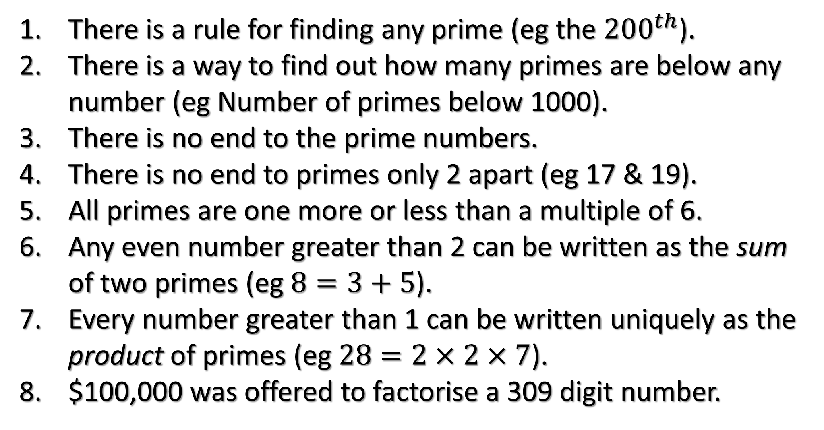
Prime Numbers – True/False
There is a rule for finding any prime (eg the ${200}^{th}$).
There is a way to find out how many primes are below any number (eg Number of primes below 1000).
There is no end to the prime numbers.
There is no end to primes only 2 apart (eg 17 & 19).
All primes are one more or less than a multiple of 6.
Any even number greater than 2 can be written as the sum of two primes (eg $8=3+5$).
Every number greater than 1 can be written uniquely as the product of primes (eg $28=2×2×7$).
$100,000 was offered to factorise a 309 digit number.

Slide 2
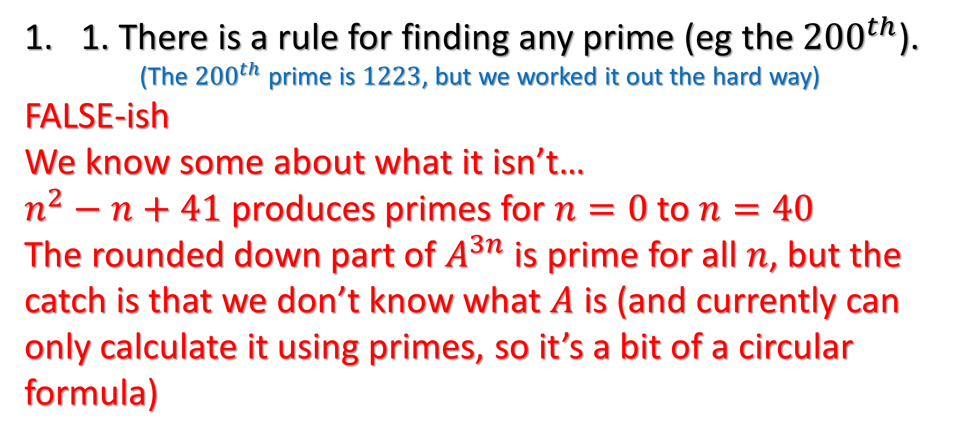
Prime Numbers – True/False
1. There is a rule for finding any prime (eg the ${200}^{th}$).
(The ${200}^{th}$ prime is $1223$, but we worked it out the hard way)
FALSE-ish
We know some about what it isn’t…
$n^{2}−n+41$ produces primes for $n=0$ to $n=40$
The rounded down part of $A^{3n}$ is prime for all $n$, but the catch is that we don’t know what $A$ is (and currently can only calculate it using primes, so it’s a bit of a circular formula)

Slide 3
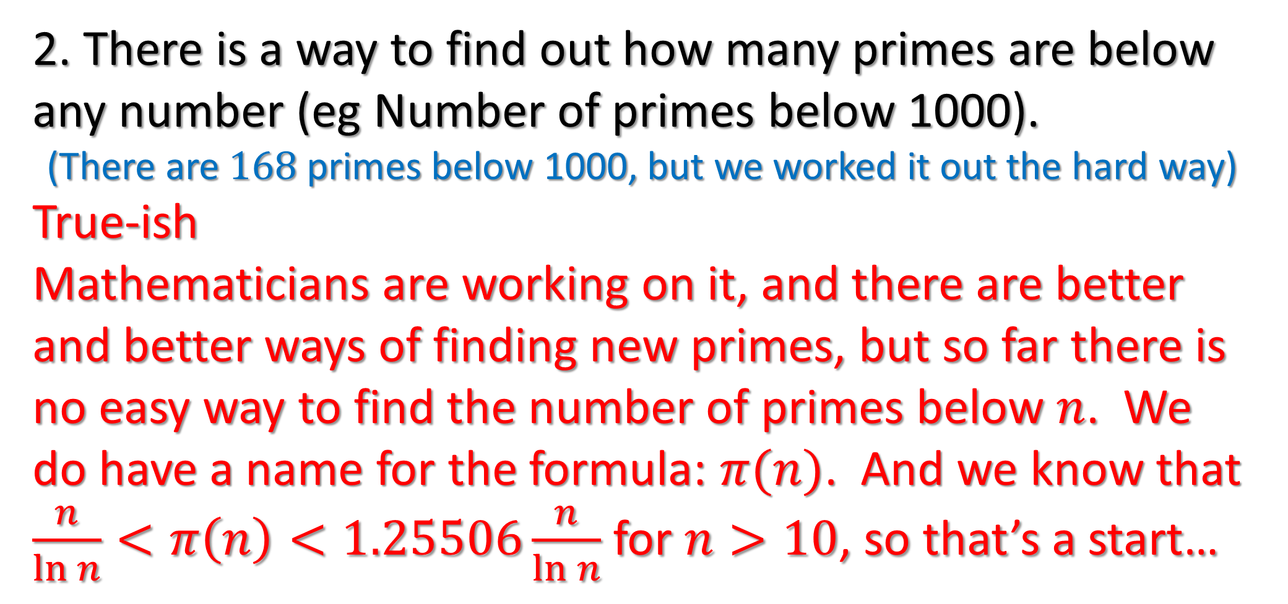
Prime Numbers – True/False
2. There is a way to find out how many primes are below any number (eg Number of primes below 1000).
(There are $168$ primes below 1000, but we worked it out the hard way)
True-ish
Mathematicians are working on it, and there are better and better ways of finding new primes, but so far there is no easy way to find the number of primes below $n$. We do have a name for the formula: $π(n)$. And we know that $\frac{n}{\ln{n}}<π\left(n\right)<1.25506\frac{n}{\ln{n}}$ for $n>10$, so that’s a start…

Slide 4
Prime Numbers – True/False
3. There is no end to the prime numbers.
True
We can prove this by assuming there is a fixed number:
Multiply all the primes together, then add 1. This number doesn’t divide by any of the primes, but all numbers greater than 1 either are prime or divide by primes. So this number either divides by primes we didn’t use, or is itself a prime we didn’t use. But we used them all!

Slide 5
Prime Numbers – True/False
4. There is no end to primes only 2 apart (eg 17 & 19).
(We’ve found the first 808,675,888,577,436 of them, but we did it the long way)
Unknown
This idea is called the ‘twin primes conjecture’.
Many mathematicians think it’s true (and even that there are an infinite number of primes 4 apart, 6 apart, 8 apart, etc) but we haven’t been able to prove it yet.

Slide 6
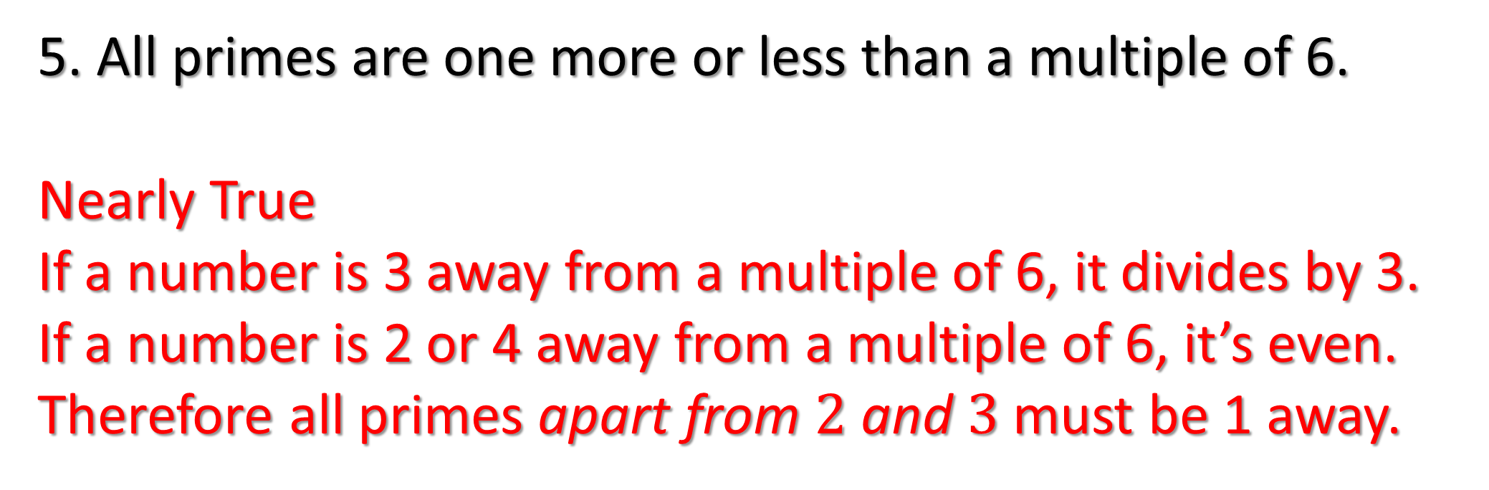
Prime Numbers – True/False
5. All primes are one more or less than a multiple of 6.
Nearly True
If a number is 3 away from a multiple of 6, it divides by 3.
If a number is 2 or 4 away from a multiple of 6, it’s even.
Therefore all primes apart from $2$ and $3$ must be 1 away.

Slide 7
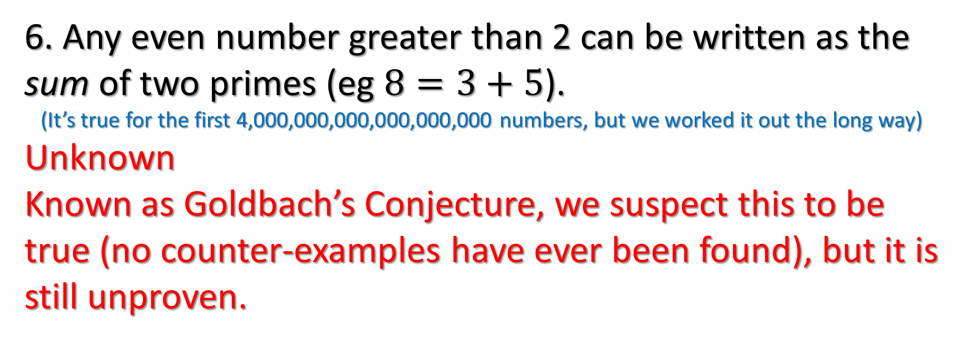
Prime Numbers – True/False
6. Any even number greater than 2 can be written as the sum of two primes (eg $8=3+5$).
(It’s true for the first 4,000,000,000,000,000,000 numbers, but we worked it out the long way)
Unknown
Known as Goldbach’s Conjecture, we suspect this to be true (no counter-examples have ever been found), but it is still unproven.

Slide 8
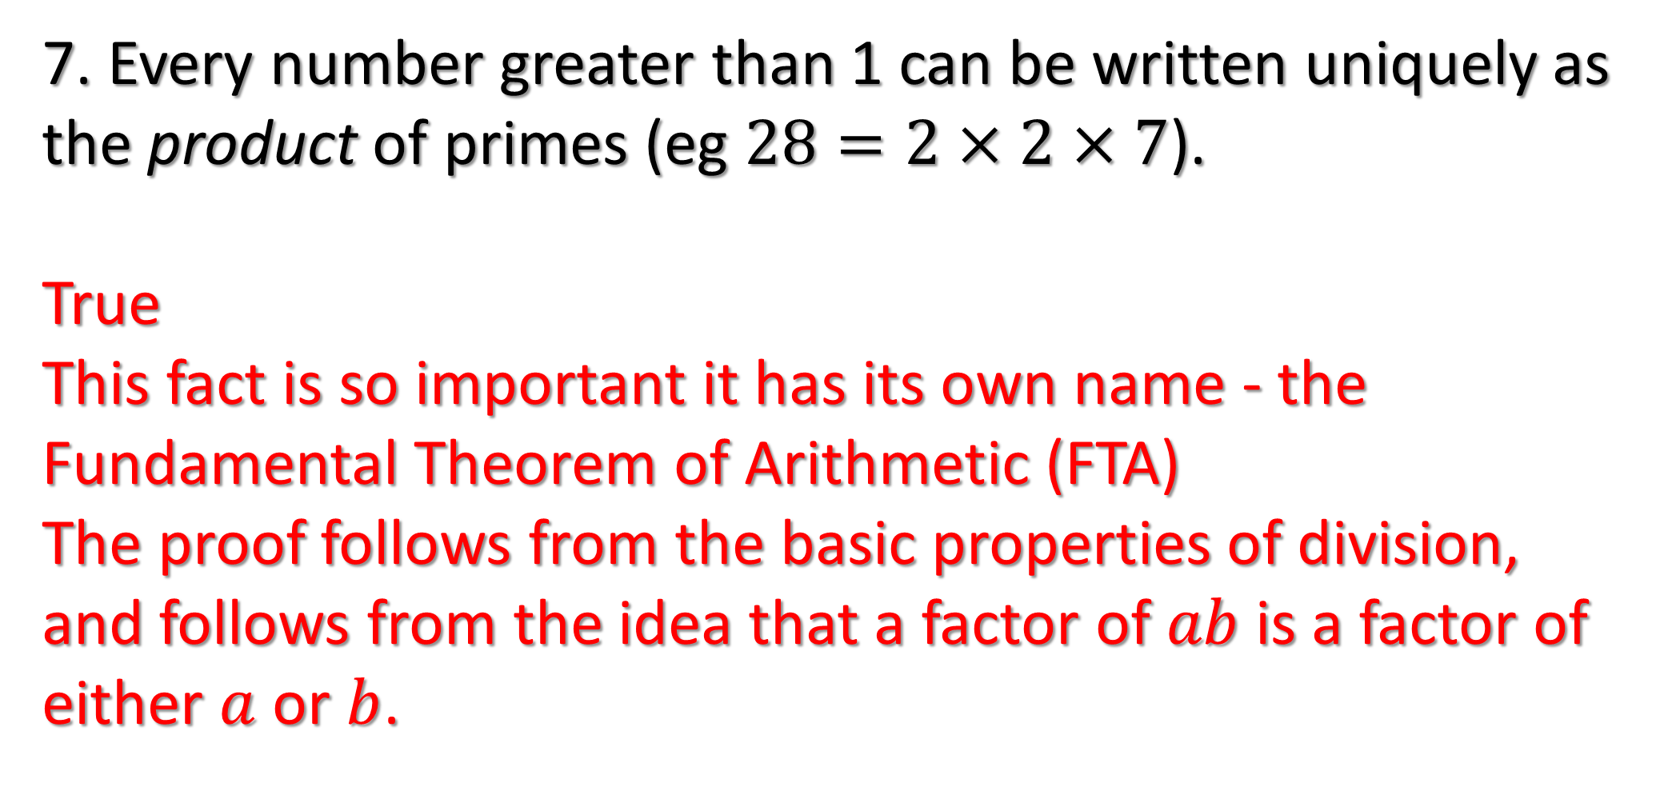
Prime Numbers – True/False
7. Every number greater than 1 can be written uniquely as the product of primes (eg $28=2×2×7$).
True
This fact is so important it has its own name - the Fundamental Theorem of Arithmetic (FTA)
The proof follows from the basic properties of division, and follows from the idea that a factor of $ab$ is a factor of either $a$ or $b$.

Slide 9
Prime Numbers – True/False
8. $100,000 was offered to factorise a 309 digit number.
True
RSA encryption is based on the difficulty of factorising large numbers. Two large primes are multiplied together to produce a ‘key’ meaning anyone can encrypt data to send to you, but only you - the person who generated the key - can decrypt it. The only known way to break the code is to split the key into its prime factors.

