Slide 1
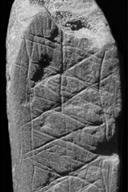
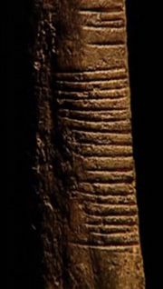
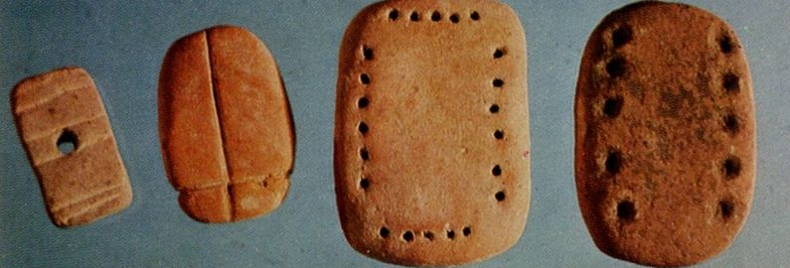
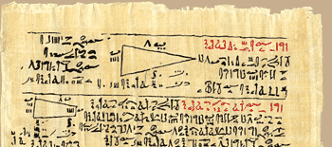
The Origins of Maths
When? Where? How? Why?
Notes:
70,000BC: South Africa – geometric figures (shapes) carved into stone
20,000BC: Africa & France – regular patterns of tally-style marks indicating counting and time-keeping
3,400BC: Mesopotamia – tokens used for calculations, currency and measurement
3,100BC: Egypt – place value and mathematical symbols used
Between 2,000BC and 1,000BC: Scotland, Russia, Germany, China – evidence of equations, approximations of pi, properties of 3D shapes
Between 1,000BC and 0BC: Egypt, India, Greece, Babylon – fractions, astronomy, infinity, square roots, types of number, base 10 system, prime numbers, trigonometry

Slide 2
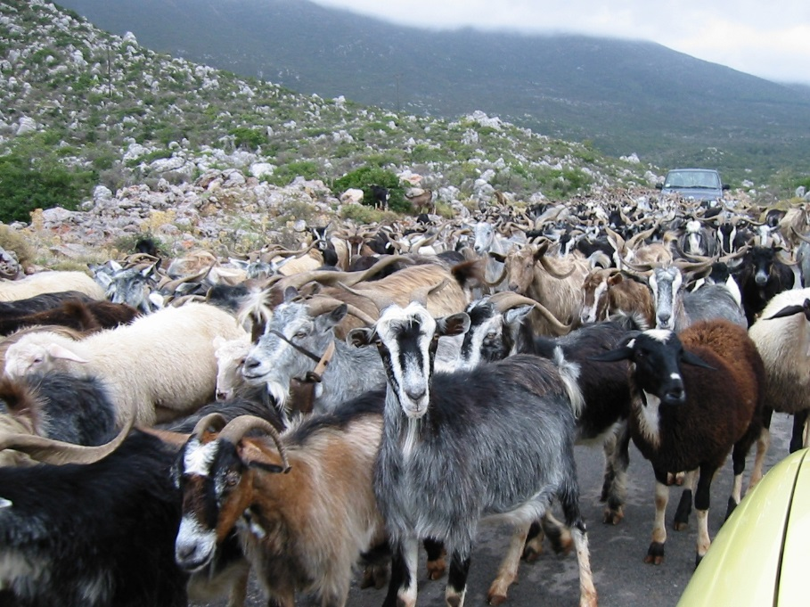
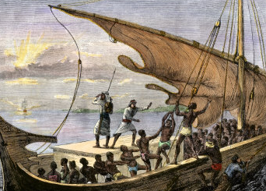
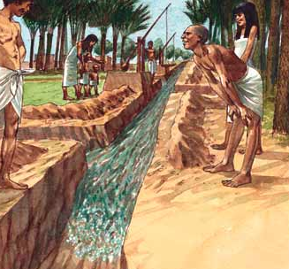
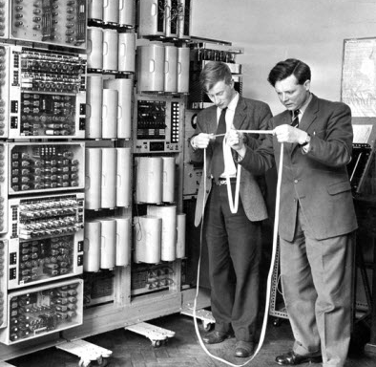
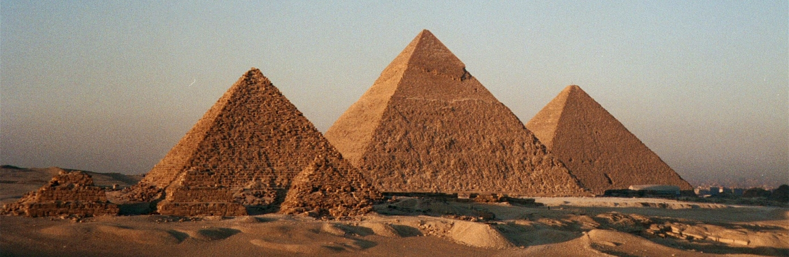

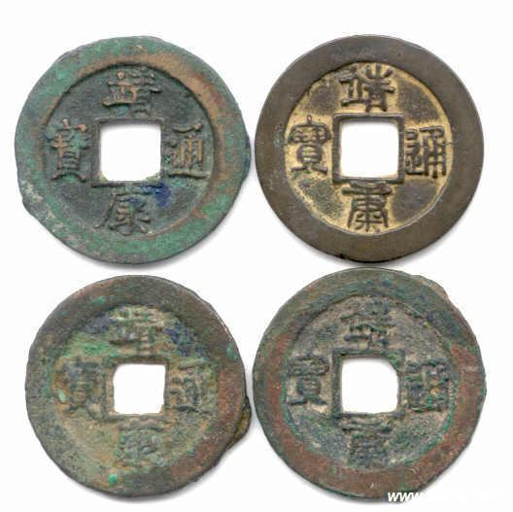
The Origins of Maths
When? Where? How? Why?
Notes:
Counting helped people keep track of possessions
Basic operations and the development of navigation techniques allowed trade and commerce to develop
More sophisticated measuring techniques and calculations allowed rulers to tax their subjects, and people to buy and sell land, grain, etc, more fairly
Keeping track of the days helped farmers to plan their crop planting and harvesting with the seasons, while maths helped them construct irrigation ditches
Place value allowed people (especially those who dealt with large numbers such as the Pharaohs) to perform large calculations and keep accurate records more easily.
Solving equations enabled people to solve more complex engineering problems.
Investigating shapes allowed us to improve our building of structures, and solve common engineering problems.
More recently, algebra and very abstract mathematics has led to the invention of computers which allow us to solve even more complicated problems.
Investigation of prime numbers, for instance, has led to modern encryption techniques – it’s what allows you to send emails or do online banking without other people stealing your information (or money!)

Slide 3
What is Maths?
Quantity Structure Space Change
Algebra
Geometry
Arithmetic
Calculus
Types of number
Fractions
Prime numbers
Calculations
Functions
Equations
Graphs
Vectors
2D & 3D shapes
Angles
Measurement
Trigonometry
Infinity
Sequences
Limits
Abstraction

