Slide 1
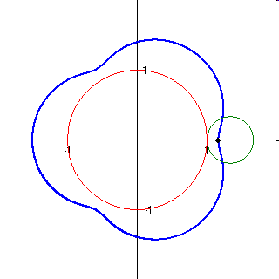
Loci and Construction
Latin word meaning ‘place’
(as in locomotive: moving place)
Today you will learn how to use Construction to provide solutions to problems involving place constraints
(eg at least 3m from a point, no further than 2m from a line, the same distance from two points, …)
Notes:
Students will need compasses, pencils and rulers. Questions involving circle calculations will require a calculator.

Slide 2
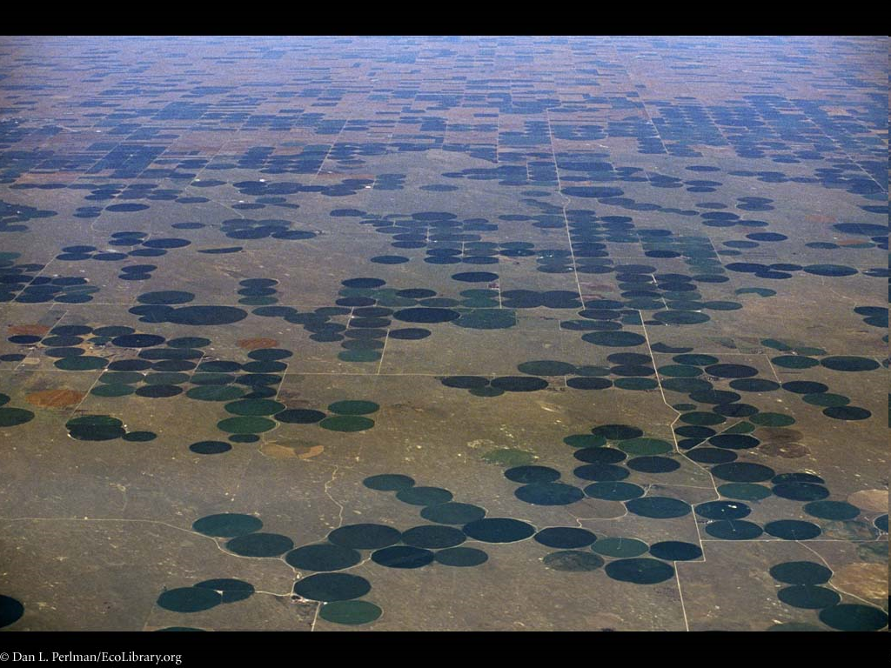
Notes:
Guess what this is. This is a photograph of irrigation circles in Colorado. A rotating boom provides water for a certain area of ground, which can then produce crops – a much darker colour than the surrounding desert.

Slide 3
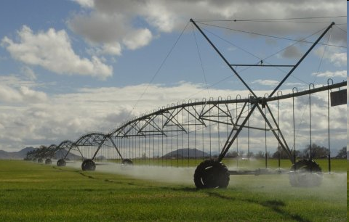
Notes:
An example of a rotating irrigation boom.

Slide 4
If I double the length of the irrigation boom, how much larger would the area watered be?
(If you need numbers, assume the boom is 100m)
What if I treble (x 3) the length?
2 times the radius gives 4 times the area.
3 times the radius gives 9 times the area.
Notes:
The values can be calculated directly using the circle area formula, but the concept of a squared scale factor is common to all linear to 2-D scale factor changes. Eg, a square of twice the length and width has 4 times the area.

Slide 5
Mark points P and Q, 4 centimetres apart, on your page.
Draw the locus of points within 3cm of P.
Draw the locus of points within 2cm from Q.
Shade the area within 3cm of P and 2cm of Q
P
Q
Notes:
The shaded area is the locus of points that fit both constraints.

Slide 6
Challenge:
Draw a rectangle (of any size), and construct the locus of points exactly 2cm away from the rectangle.
Notes:
The key point here is that a fixed distance from a line is a parallel line, but the fixed distance from a point (eg, a corner) will form a circle.

Slide 7
Solution
Notes:
The resulting locus is a combination of straight lines directly beside the straight sides of the rectangle and portions of circles (in the case of a rectangle, quarter-circles) at each corner.

Slide 8
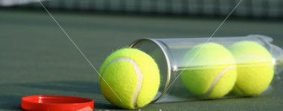
True or False?
“The distance around the rim of a canister of tennis balls is greater than the height of the canister”
Notes:
The key points are that the canister holds 3 balls, so its height is 3 x the diameter of a ball. The distance around the rim is the same as the circumference of a ball, which is pi x the diameter. Therefore, since pi is slightly more than 3, the distance around will be (slightly) greater than the height.

Slide 9
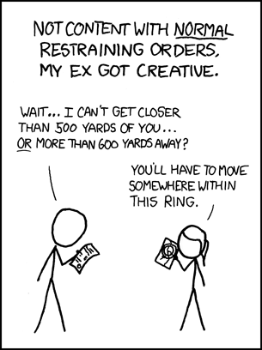
How much space is he free to move around in?
(ie What is the area of the described locus?)
Area of large circle: π x 600² = 1,130,973 yd²
Area of small circle: π x 500² = 785,398 yd²
Large – Small = 345,575 yd²
= about 70 acres (the size of a large field)
500yds
600yds
Notes:
The first important part here is visualising the locus. Secondly, being able to apply circle formulae to a compound area problem.

Slide 10
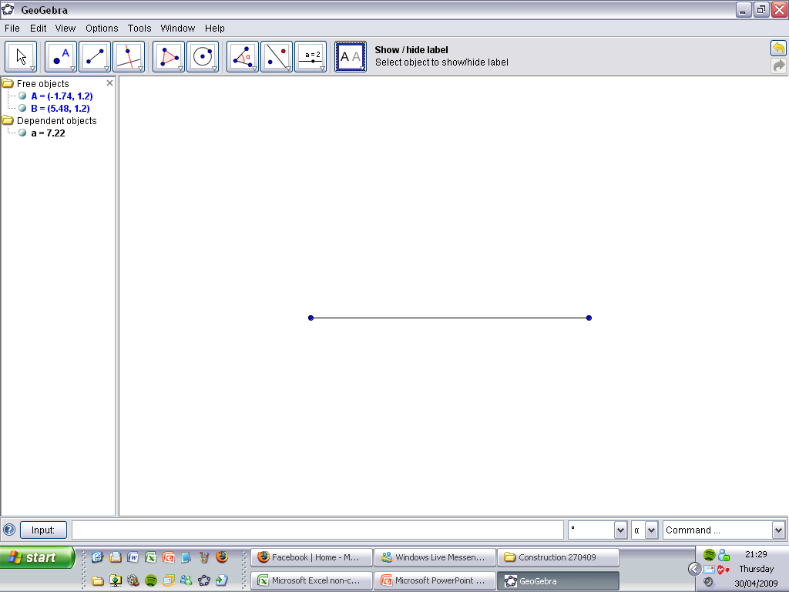
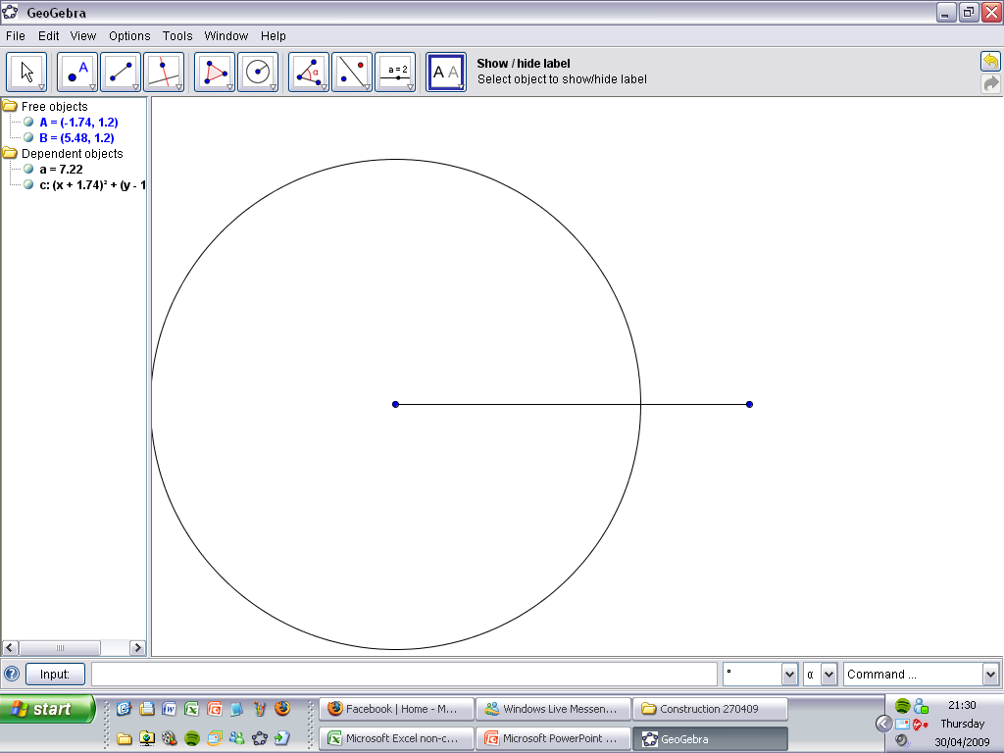
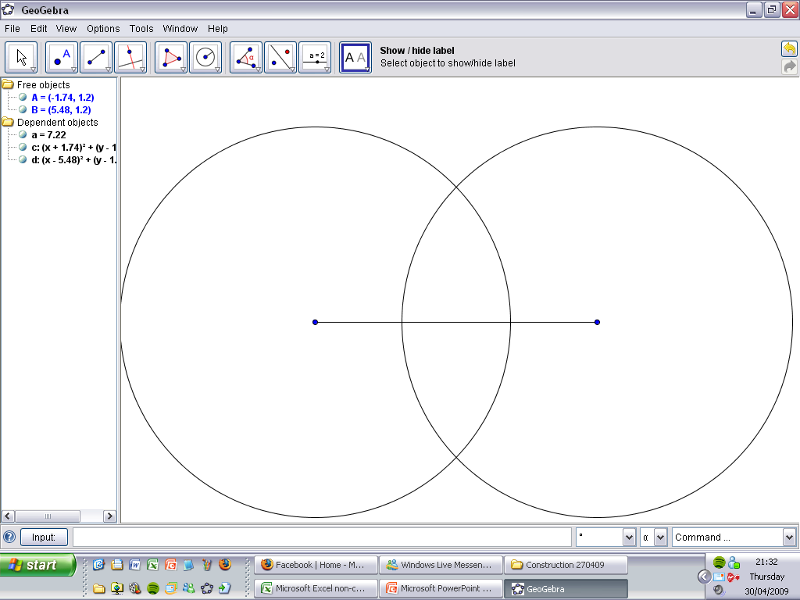
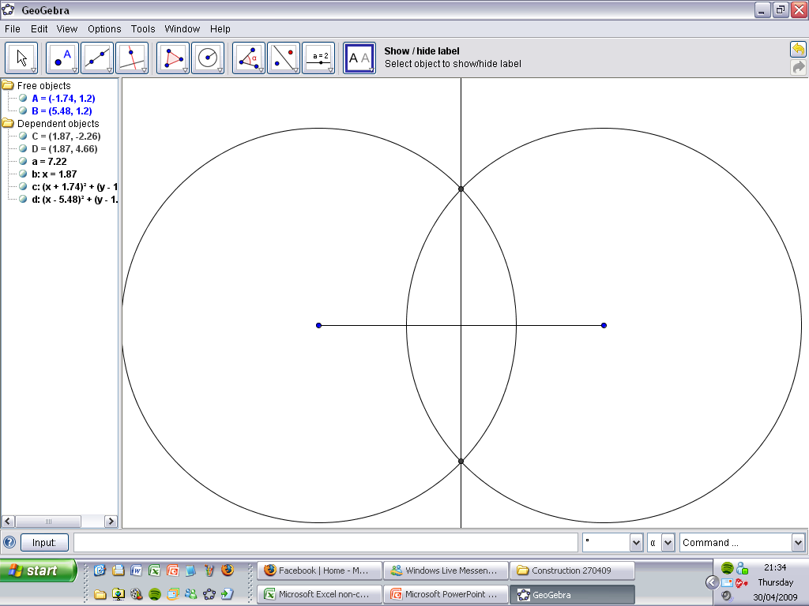
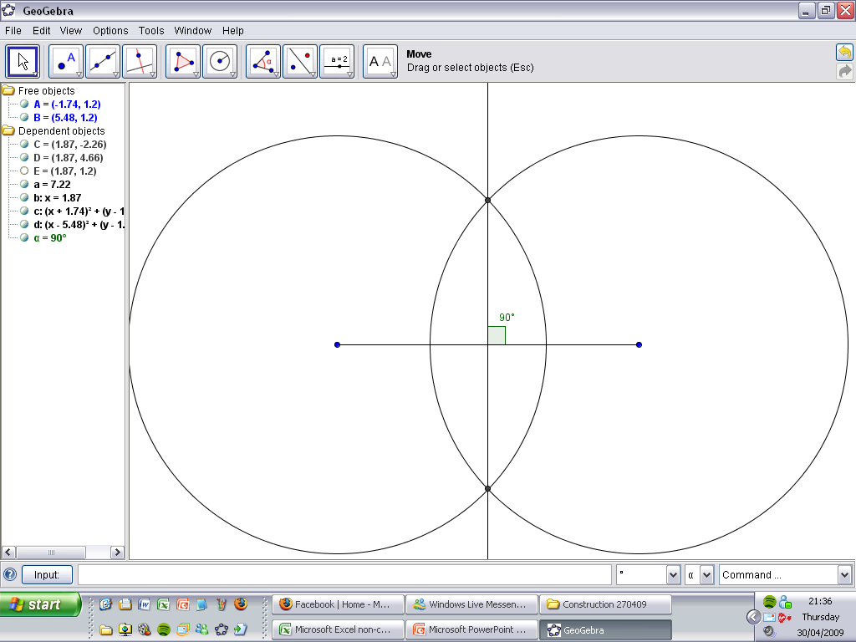
Perpendicular Bisector
At right angles
2 equal pieces
Notes:
This demonstrates the method for constructing a perpendicular bisector. The two circles must be the same size, and they need to be large enough to overlap (preferably overlap quite a bit for best results), but not so large that their crossing points are off the page. Since joining the end points with either of the overlapping points would produce an isosceles triangle (which is symmetrical), the original line must have been cut into two identical pieces, at identical angles (which, since they add up to 180, must each be 90).

Slide 11
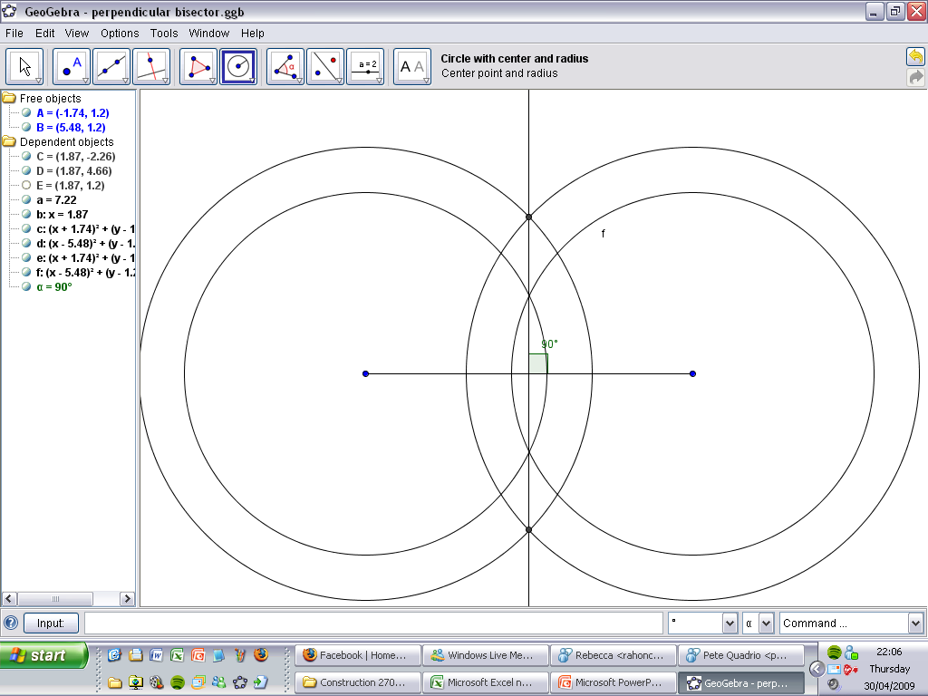
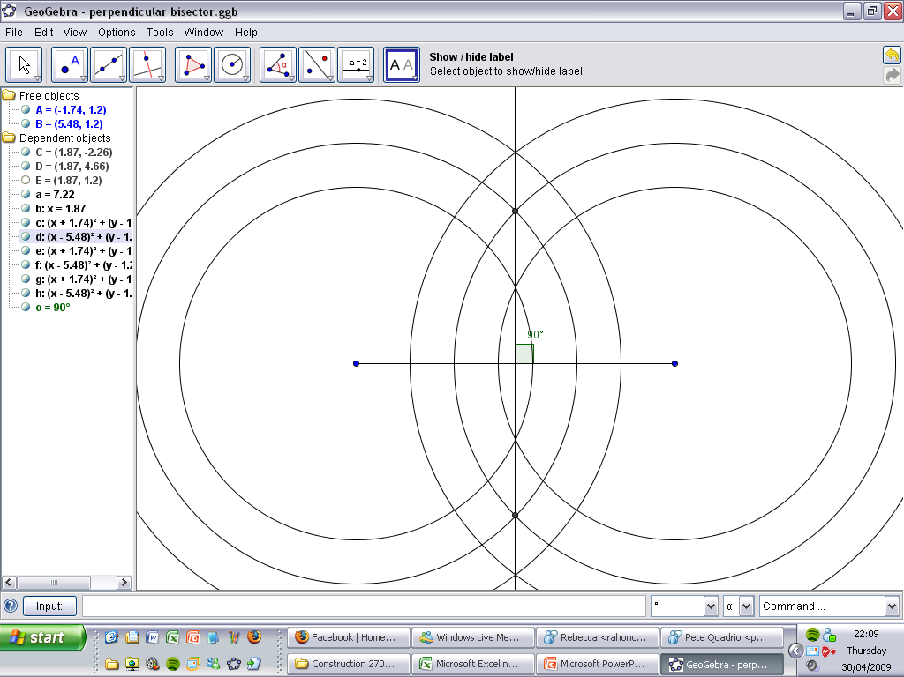
Notes:
This simply demonstrates that the size of circle, provided it’s the same as the second one, doesn’t change where the line goes.

Slide 12
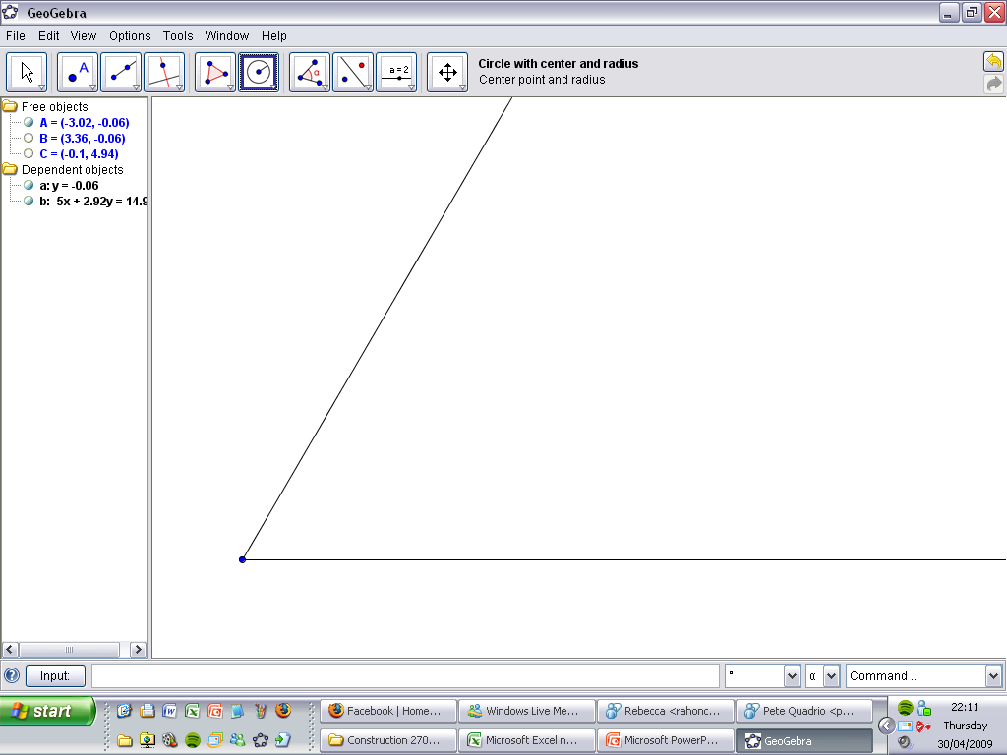
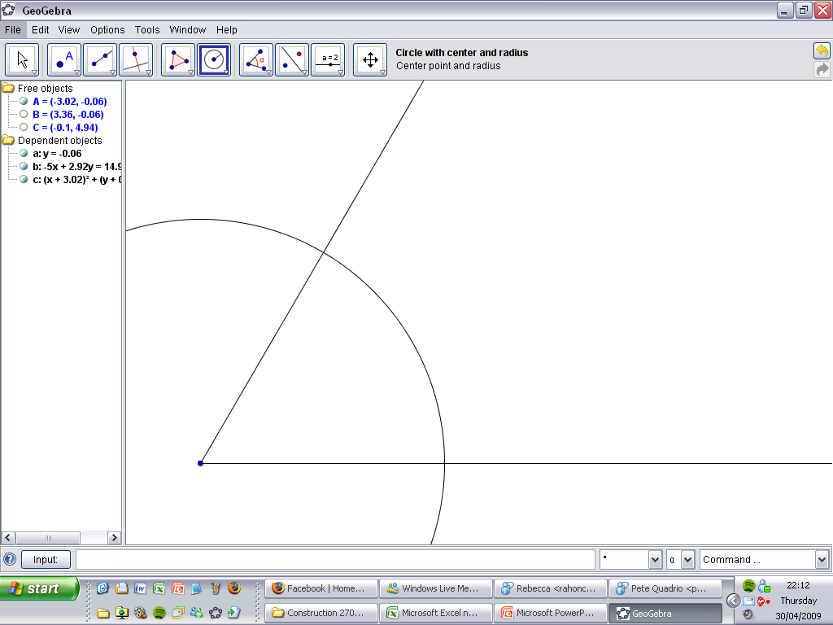
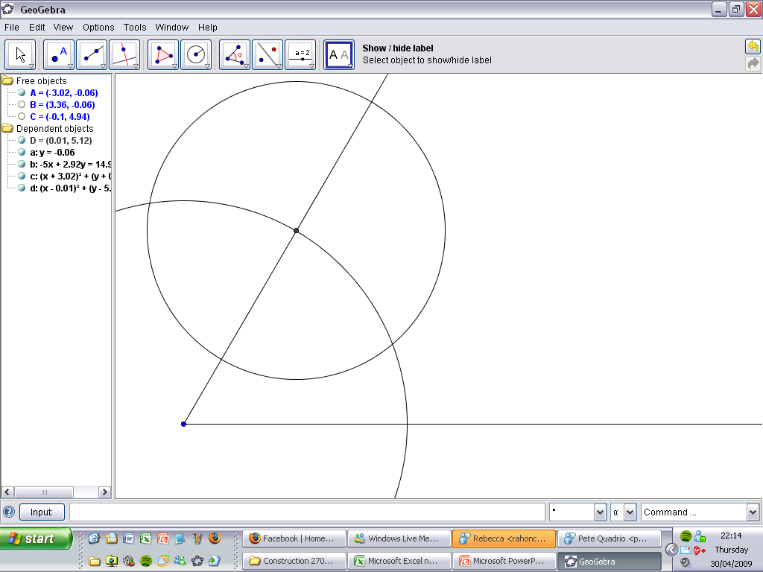
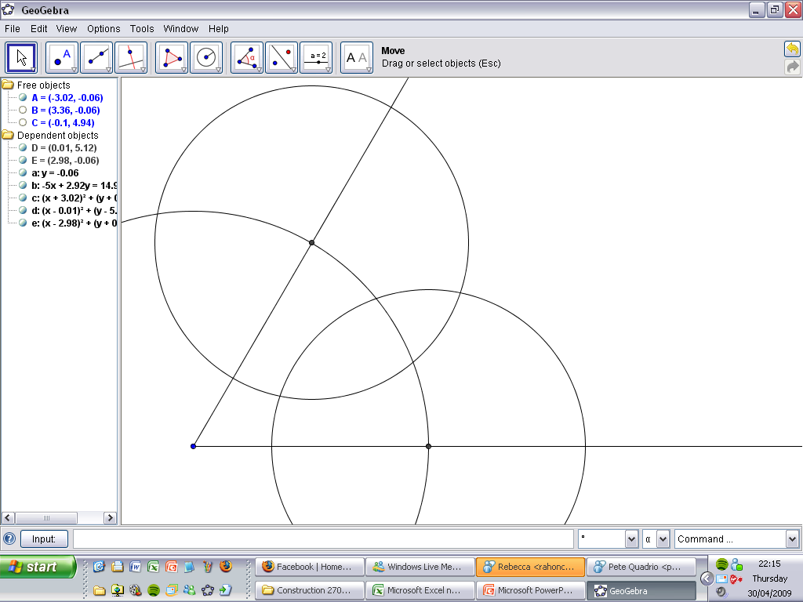
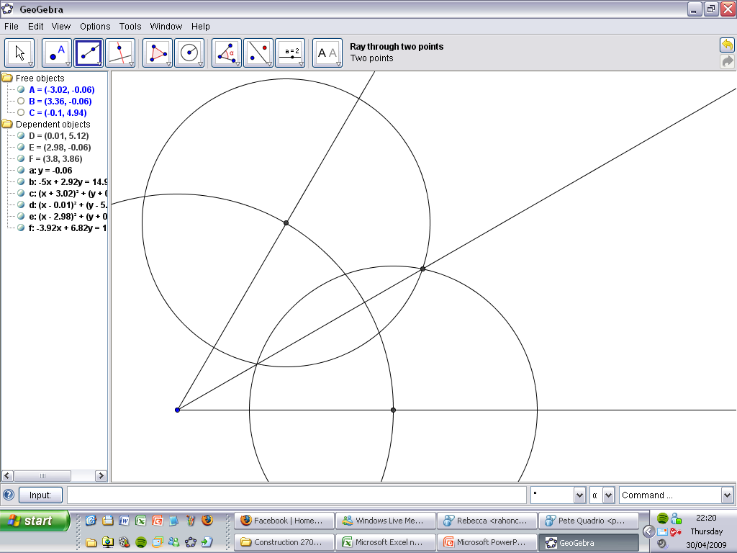
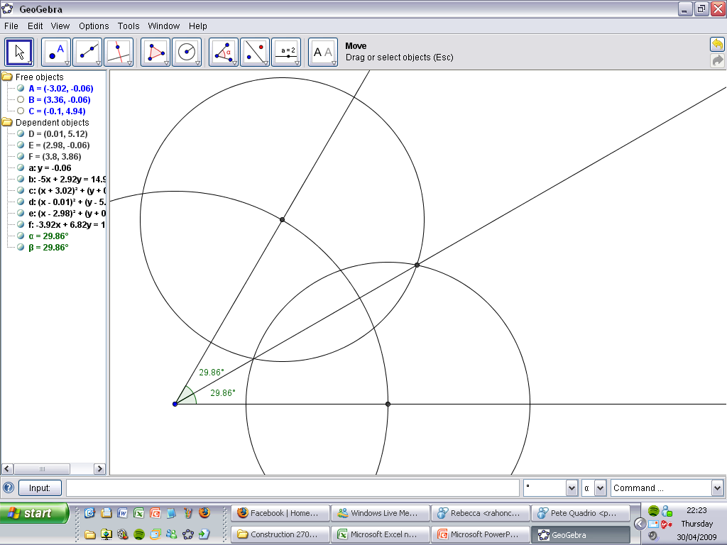
Angle Bisector
2 equal angles
Notes:
For an angle bisector, the first circle is simply a way of identifying two points the same distance from the ‘corner’. The next part is then a perpendicular bisector between the two crossing points. These circles should ideally be smaller than the first, so that you have two crossing points in addition to the corner itself. This gives additional confidence in the accuracy of the line.

Slide 13
Equidistance from 2 points
Equal Distance
Notes:
This demonstrates the link between equidistance from two points and a perpendicular bisector.

Slide 14
Equidistance from 2 lines
Notes:
This demonstrates the link between equidistance from two lines and an angle bisector. The key point is that the shortest distance from a point to a line is at right angles to the line, and this produces identical (congruent) right-angled triangles.

Slide 15
Constructing Bisectors – recap
Points equidistant from two points form a perpendicular bisector
Points equidistant from two lines form an angle bisector
Notes:
Perpendicular bisector, Angle bisector

Slide 16
Recap
Points equidistant from one point form a circle
Points within a given distance from a point form a shaded circle
Notes:
Circle, Shaded Circle (the points within the circle are also included in the locus in the second case)

Slide 17
Shade in the part of the square that is:
Closer to A than C, and
Closer to B than D
A
B
D
C
Notes:
The line of equidistance between A and C is the line BD. Anything to the left (and above) this line is closer to A. Similarly for B and D.

Slide 18
Shade in the part of the square that is:
Closer to the left side than the right side, and
Closer to the base than the top
A
B
D
C
Notes:
This is effectively a distance from a line. Since the lines in question are parallel, it’s not exactly an angle bisector, but the middle lines drawn are equidistant from the two pairs of opposite sides.

Slide 19
Grazing sheep
Notes:
Explain that the sheep is tethered to the point P on the edge of the barn by a rope that is 4 m long. Ask pupils to describe the region of grass that the sheep can graze.
Click on the red points in turn to illustrate the region on the board and emphasize the radius of each arc. Explain that as the sheep gets to the corners there is less rope left and so the radius of the sector will be reduced. Also, the centre changes from the point the sheep is tethered to whichever corner the rope has had to turn around.
Change the point from which the rope is attached. Repeat the activity to investigate which position would give the sheep the largest grazing area.

Slide 20
Calculate the area that may be grazed by a llama tied by a 5 metre rope to the side of a 3 by 3 metre square barn,
a) at a corner, b) in the middle of one side
¾ of pi x 5²
+ ½ of pi x 2²
= 20.75 x pi
= 65.2m²
5m
2m
Notes:
Use the same strategies to draw the locus, then apply circle formulae to find the area grazed.

Slide 21
Calculate the area that may be grazed by a llama tied by a 5 metre rope to the side of a 3 by 3 metre square barn,
a) at a corner, b) in the middle of one side
½ of pi x 5²
+ ½ of pi x 3.52
+ ½ of pi x 0.52
= 37.5 x pi
= 58.9m²
5m
3.5m
0.5m
Notes:
The middle of one side version. If a full investigation is done, students should discover that the corner is the optimal solution, since this gives the maximum portion of a circle with maximum radius. Even if there are more of the smaller pieces by attaching at the side, this is not enough to compensate. Recall that a circle with half the radius only covers a quarter of the area.

