Slide 1
The Impossible Triangle
?

Slide 2
Copy and cut out these four shapes.
Then assemble them as shown:

Slide 3
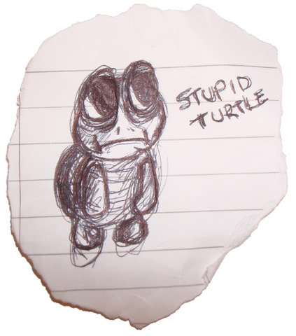
Now rearrange your pieces to produce this shape:
The new shape is the same size, but it has a bigger area – magic!

Slide 5
Answer:
It’s a trick!
These shapes look like triangles, but they aren’t:

