Slide 1
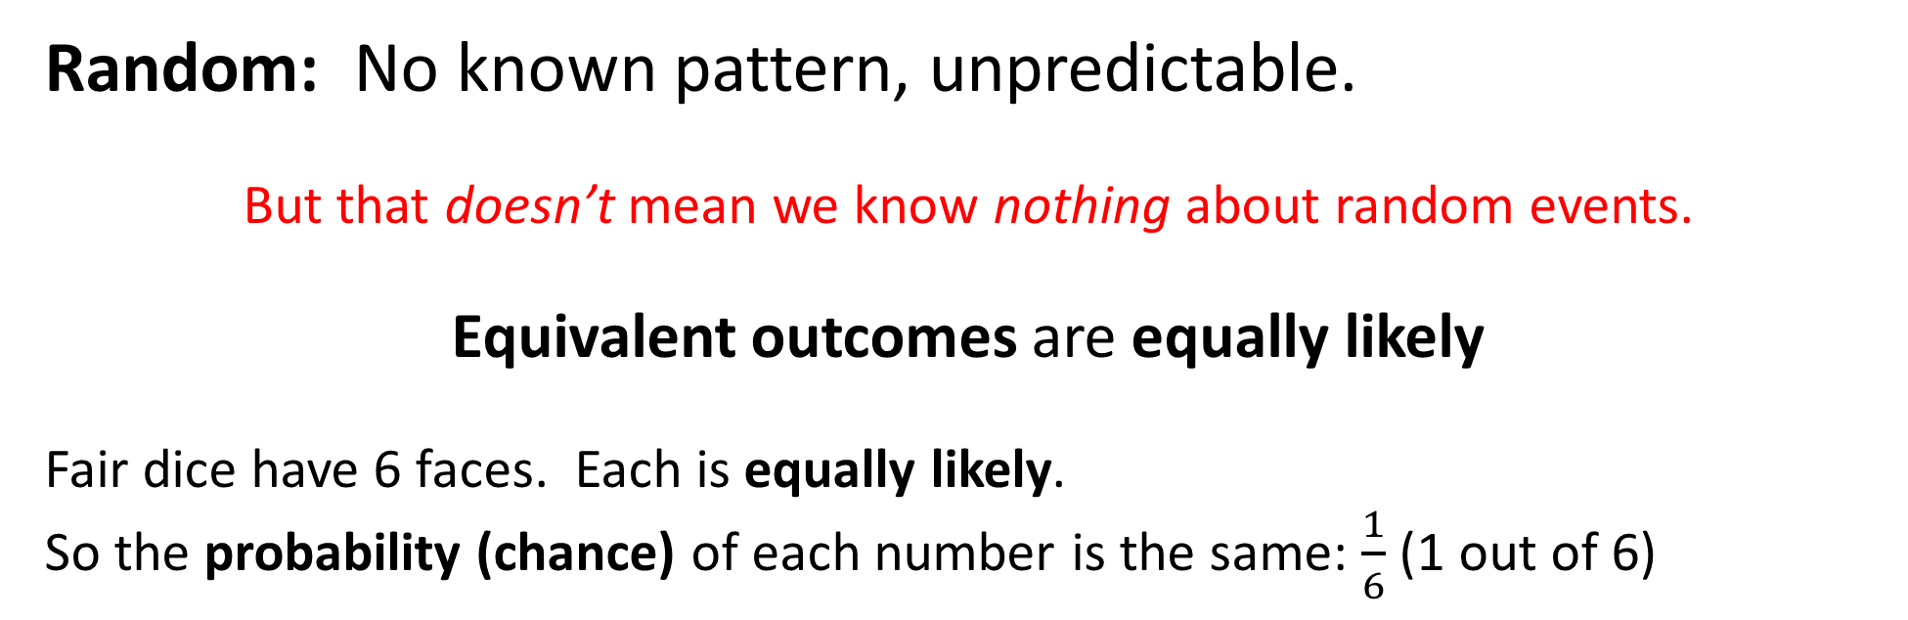
What does ‘random’ mean?
Random: No known pattern, unpredictable.
But that doesn’t mean we know nothing about random events.
Equivalent outcomes are equally likely
Fair dice have 6 faces. Each is equally likely.
So the probability (chance) of each number is the same: $\frac{1}{6}$ (1 out of 6)

Slide 2
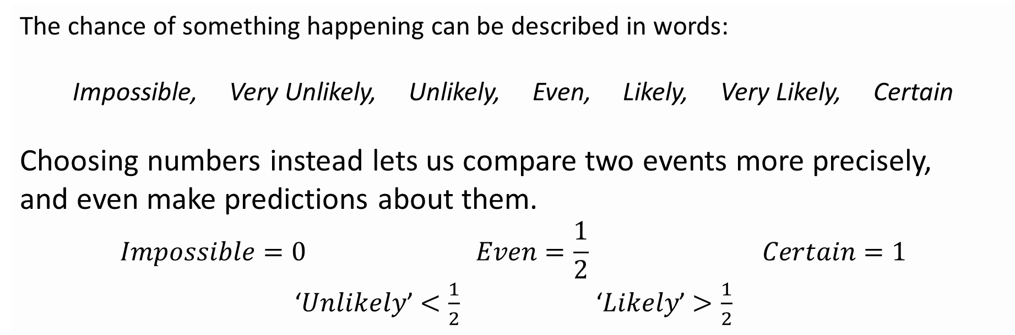
Probability
The science of randomness
The chance of something happening can be described in words:
Impossible, Very Unlikely, Unlikely, Even, Likely, Very Likely, Certain
Choosing numbers instead lets us compare two events more precisely,
and even make predictions about them.
$$Impossible=0 Even=\frac{1}{2} Certain=1$$
‘$Unlikely$’ $<\frac{1}{2}$ ‘$Likely$’ $>\frac{1}{2}$

Slide 3
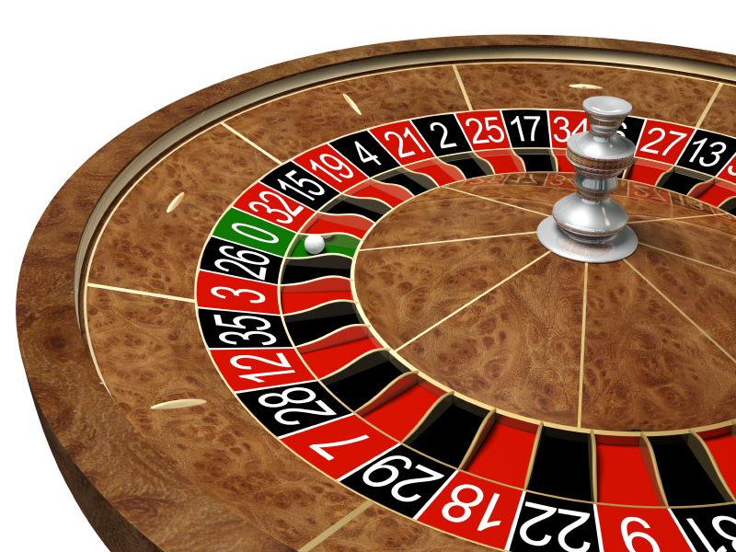
On one occasion, in a Monte Carlo casino, a roulette wheel came up black 20 times in a row.
Would you bet red or black for the next throw?
Why?
Throw 21:
Throw 22:
Throw 23:
Throw 24:
Throw 25:
Throw 26:
Throw 27:
Throw 28:
Throw 29:
Throw 30:
Black
Black
Black
Black
Black
Black
Red
Red
Black
Red
Notes:
On August 8th in 1913, the roulette wheel showed up black 26 times in a row. Some bet on black assuming the streak would continue (and lost big when it eventually stopped), and some bet on red, assuming the streak was almost certain to end soon (and lost big before red ever came). If you have to double up every time you lose to cover your losses, 26 losses in a row would mean you’d need a bank roll of over half a billion to cover an initial £10 bet (you’d only come out with a £10 profit).

Slide 4
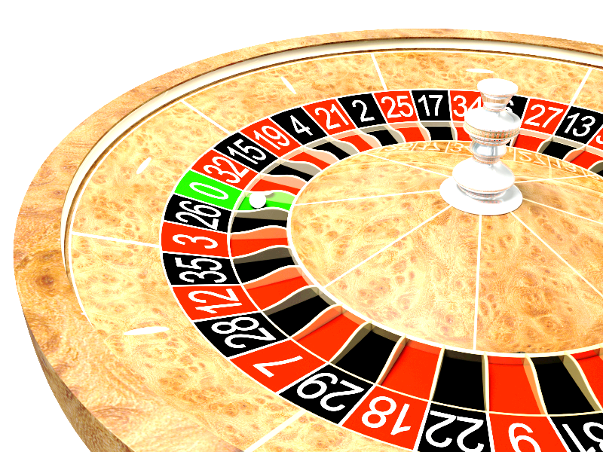
The Gambler’s Fallacy
A commonly held (if often subconscious)
Belief that is the result of a logical error.
If you keep playing whether you’re winning or losing, what is the only thing that will make you stop?
“I’m losing, so I need to keep playing – sooner or later I’ll start to win, then I can recover my losses”
“I’m winning, so I need to keep playing – I’ve hit my streak; I can’t stop now.”

Slide 5
Probability Challenge
Imagine you toss a coin 20 times. Write down a list of H’s and T’s to represent what you might expect to get. Make it look as realistic as possible!
Actually toss a coin 20 times and write down the outcome of the throws in order.
I will look at your two sets of results and try to guess which one is genuine and which one you made up.

Slide 6
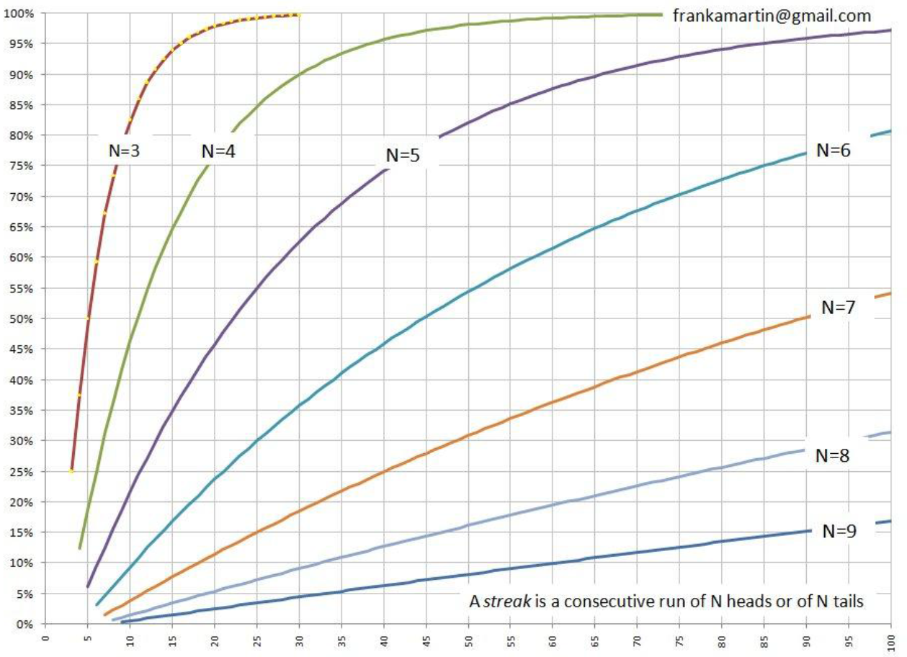
There is a 45% chance of getting a run of 5 heads or tails when you toss a coin 20 times

