Slide 1
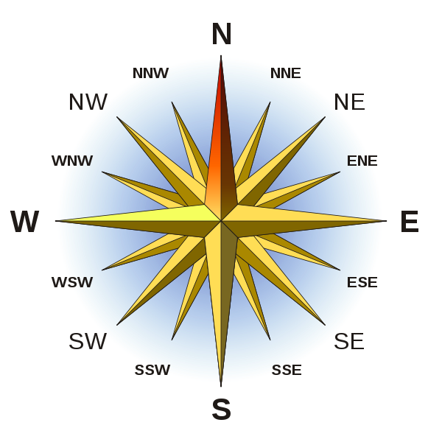
Compass
Rose
000
337.5
022.5
315
045
292.5
067.5
270
090
247.5
112.5
225
135
202.5
157.5
180

Slide 2
N
N
B
60º
Bearing of B from A =
060º
A
How to find a bearing:
Draw a line between the points
Draw the North line on the first point
Measure the angle clockwise from North
Write the result as 3 digits (eg 345º or 012º)

Slide 3
N
N
B
180º
60º
A
Bearing of A from B =
180º + 60º
= 240º
Opposite directions are always 180º apart

Slide 4
A
D
B
C

Slide 5
Margin of error:
Bearings should be correct to within 2 degrees ( ½ a mark for 5 degrees out)
Distances need to be correct to within 5 metres ( ½ a mark for 10 metres out)

Slide 6
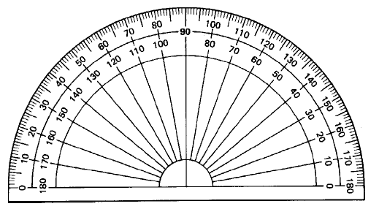
How to pinpoint a location using bearings
Try to work out how bearings could help you locate a ship in distress.
N
360° - 275° =
85°
N
058°
275°
Construct the bearing from each point.
Extend the lines until they cross.
The crossing point is the location.

Slide 7
A
D
F
B
C

