Slide 1
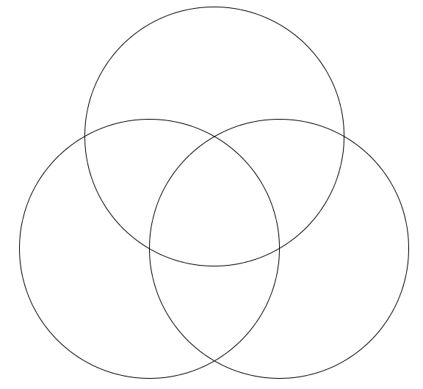
Things I’m good at
Find a way to make it fun?
Find a way to make it pay?
Untangling rope
Proof reading
Chopping logs
Perfect career
Teaching maths
Interior decorating
Singing
Plumbing
Things people pay for
Find a way to get better at it?
Things I enjoy doing

Slide 2
Flour
Flour
Pasta
Batter
Pancakes!
Milk
Egg
Omlette
Milk
Egg

Slide 3
Toyota
Toyota
Hilux
Bugatti Veyron
Toyota
Prius
Toyota
Previa
Toyota Corolla
Vauxhall Corsa
VW Golf
Peugeot 106
Under £1500
Better than 40mpg

Slide 4
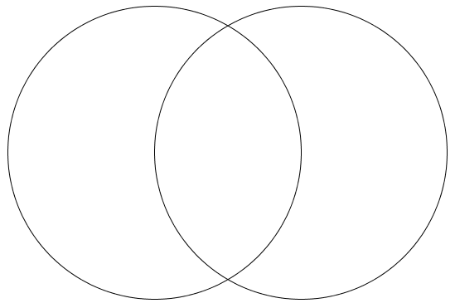
Put the following Pixar movies in the Venn diagram:
Main character
doesn’t need to breathe
Main character
would fit in a pencil case
Toy Story
A Bug's Life
Monsters, Inc
Finding Nemo
The Incredibles
Cars
Ratatouille
WALL-E
Up
Brave
Cars
WALL-E
Toy Story
Finding Nemo
A Bug's Life
Ratatouille
Up
Brave
Monsters, Inc
The Incredibles
What is the chance of a movie from the list chosen at random having a main character who:
Fits in a pencil case?
Doesn’t need to breathe?
Both?

Slide 5
Place all the whole numbers from 1 to 30 in the Venn diagram:
Prime Numbers
7
11
I pick a number between 1 and 30. What is the chance that it:
Is either a factor of 60 or a multiple of 5?
Is a prime factor of 60?
Is a prime multiple of 5?
Is not a factor of 60, multiple of 5 or a prime?
13
19
17
29
8
23
21
3
9
22
2
24
5
14
1
26
4
16
27
10
20
6
25
15
18
28
12
30
Factors of 60
Multiples of 5

Slide 6
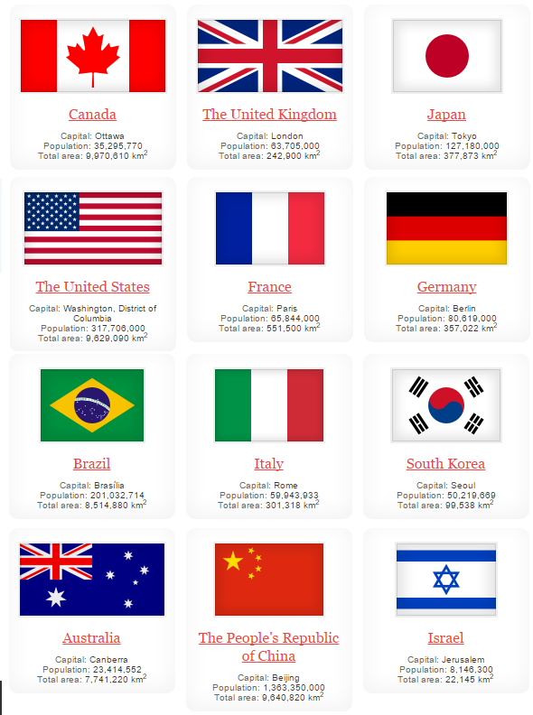
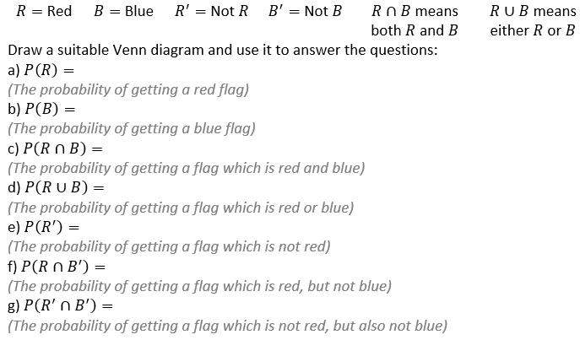

Slide 7
