Slide 1
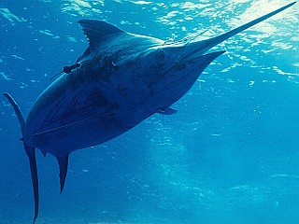
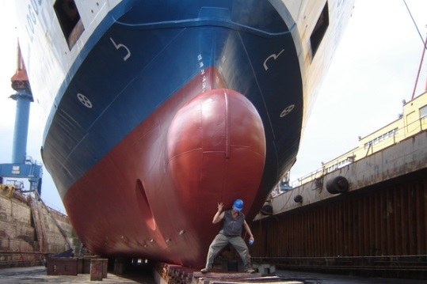
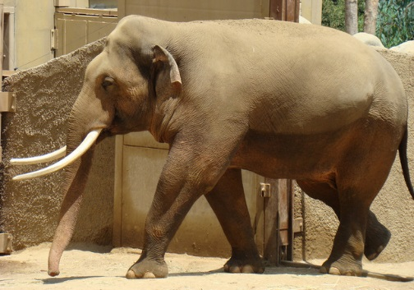
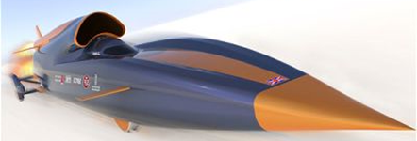
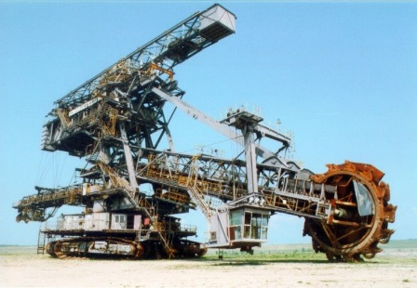
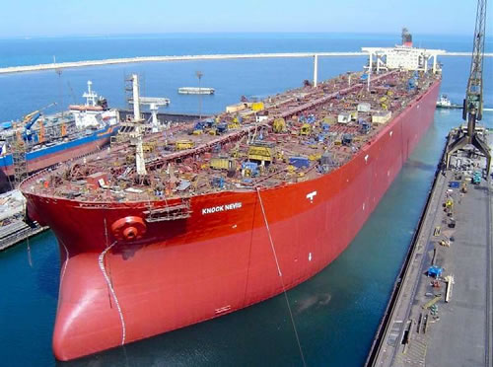
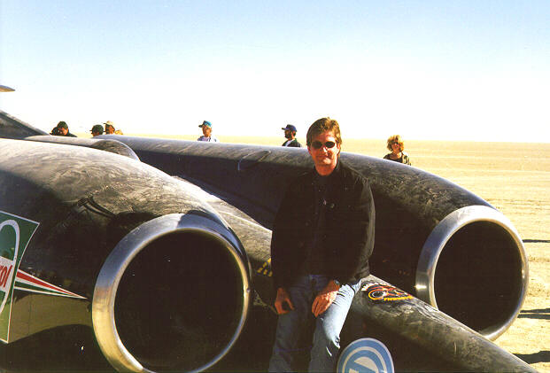
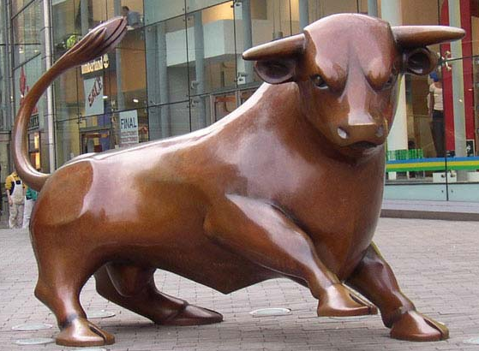
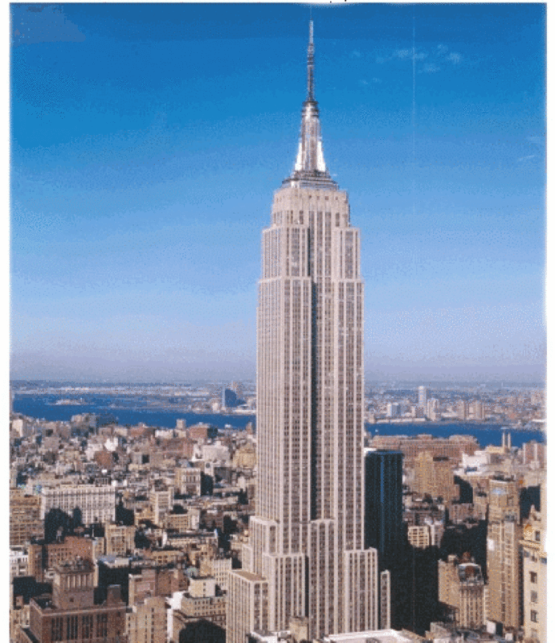
Big Things
In your teams, you will get
three guesses: I’ll tell you
‘too high’ or ‘too low’, then
you make a final prediction.
Notes:
The Big Things Quiz – groups will need to write down their answers for the first 7 questions, then the next 7 slides show answers (along with the alternatives for different amounts). There are 3 bonus questions at the end which are possible to work out with a bit of general knowledge and mathematical know-how.

Slide 2
1. Fastest car in the world
Notes:
The Thrust SSC, powered by jet engines, broke the sound barrier, and currently lives at Coventry Transport Museum.

Slide 3
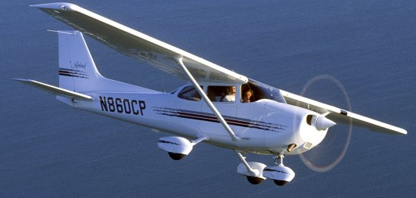
1. Fastest car in the world
142mph
763mph
1050mph
Notes:
The Cessna 172, the plane of choice for learner pilots (AKA Ford Fiesta of the skies), travels at 142mph. The Bloodhound SSC is run by a hybrid jet and rocket engine and, while not yet built, is expected to reach 1050mph. At this speed it covers a mile in 3.5 seconds, and could overtake a Euro fighter jet.

Slide 4
2. Tallest building in the world
Notes:
Much of the construction is iron – this figure is the total weight of the structure.

Slide 5
2. Tallest Building in the world
828 metres
443 metres
1,085 metres
Notes:
The Empire State Building is taller than the Eiffel Tower, but Mount Snowden, in Wales, is more than three times the size. (Everest is 8 times as tall again)

Slide 6
3. Heaviest ship in the world
Notes:
The Knock Nevis supertanker, when full, has too great a draft to navigate the English Channel. It can only berth in a handful of the largest ports on the planet and is used mostly nowadays as an off-shore base.

Slide 7
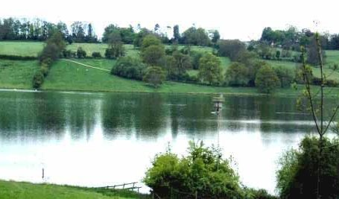
3. Heaviest ship in the world
12,500 tonnes
261,000 tonnes
154,000 tonnes
124,000,000 tonnes
Notes:
The Logos Hope is the largest floating bookshop in the world, but is itself dwarfed by the Freedom of the Seas, the largest cruise-liner in the world. Rutland Water is a reservoir in Leicestershire that measures less than 20 miles around, and yet holds 124 million tonnes of water.

Slide 8
4. Fastest Land Creature
Notes:
The Cheetah can accelerate from 0 to 63mph in just 3 seconds – faster than most supercars.

Slide 9
4. Fastest Land Creature
200mph
75mph
60mph
Notes:
The cheetah regularly hits a top speed, at the height of its sprint, of 70 to 75mph. A camel can travel at 40mph – the same speed as a greyhound, some horses up to 50mph, and the sailfish beats even the swordfish’s 60mph with a top speed of 68mph. The Peregrine Falcon has been recorded at 185mph, but this involves a high speed dive through the air. No doubt a cheetah might top 75mph if dropped from a plane…

Slide 10
5. Longest land vehicle
Notes:
This monster vehicle is used in Australia to clear mines.

Slide 11
5. Longest land vehicle
40 metres long
220 metres long
215 metres long
Notes:
The Australian mine clearer narrowly beats this enormous digging machine, and the space shuttle launch platform is transported by means of this 40m by 40m tracked vehicle.

Slide 12
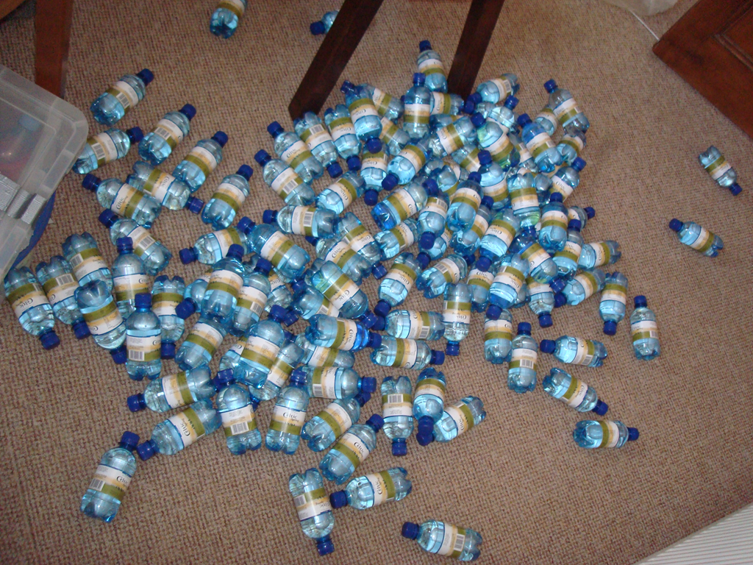
How many bottles are there?
107
Notes:
107 bottles. Note: taking answers sequentially from groups gives the final guessers an unfair advantage – try to ensure all answers are written prior to sharing. Another way of doing this is give each team a first guess, tell them ‘too high’ or ‘too low’, then allow one final (secret) guess from each team as their final answer.

