Slide 1
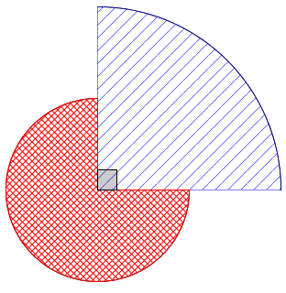
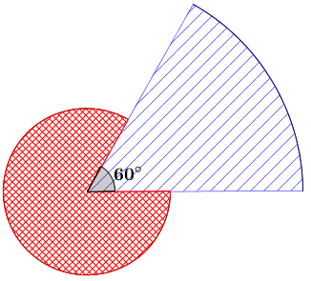
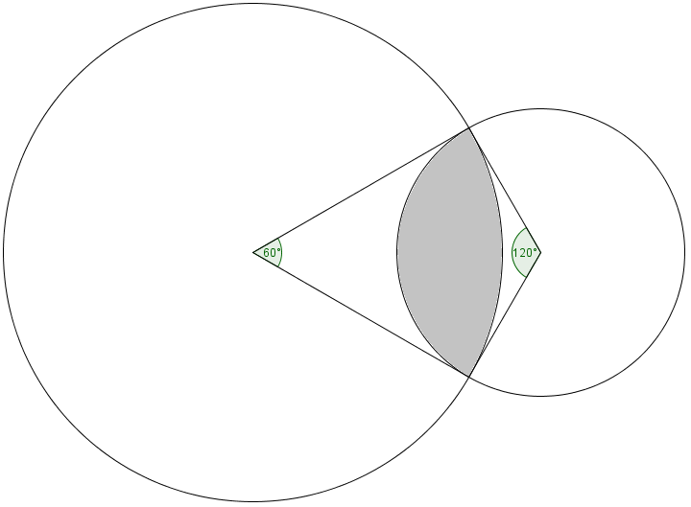
If the radius of the small circle is $1cm$, find the area enclosed by both circles.
(the angles are $60°$ and $120°$)
If the red sector has radius $2cm$, what must the radius of the blue sector be if it has the same area?
(the angle is $90°$)
If the red sector has radius $1m$, what must the radius of the blue sector be if it has the same perimeter?
(the angle is $60°$)

Slide 2
Area of red sector: $\frac{3π{\left(2\right)}^{2}}{4}=3π$
Area of blue sector: $\frac{πr^{2}}{4}$
$$3π=\frac{πr^{2}}{4} ⟹ r=\sqrt{12}=2\sqrt{3}$$
If the red sector has radius $2cm$, what must the radius of the blue sector be if it has the same area?
(the angle is $90°$)

Slide 3
Perimeter of red sector: $\frac{5\left(2π\left(1\right)\right)}{6}+2(1)=\frac{5π}{3}+2$
Perimeter of blue sector: $\frac{2πr}{6}+2r=\left(\frac{π}{3}+2\right)r$
$$\frac{5π}{3}+2=\left(\frac{π}{3}+2\right)r ⟹ r=\frac{5π+6}{π+6}$$
If the red sector has radius $1m$, what must the radius of the blue sector be if it has the same perimeter?
(the angle is $60°$)

Slide 4
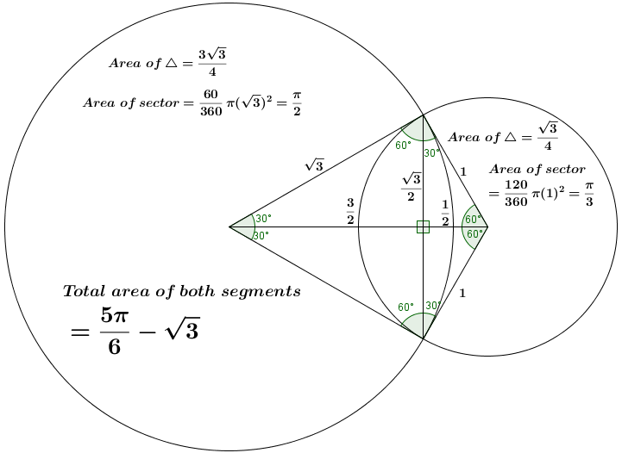
If the radius of the small circle is $1cm$, find the area enclosed by both circles.
(the angles are $60°$ and $120°$)

