Slide 1
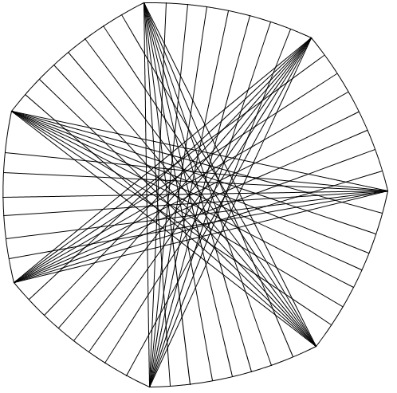
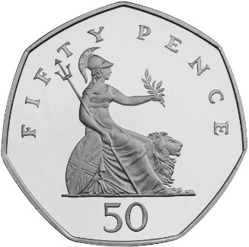
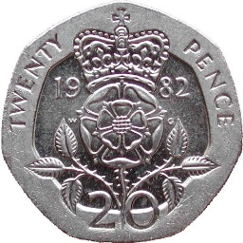
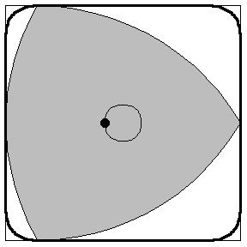
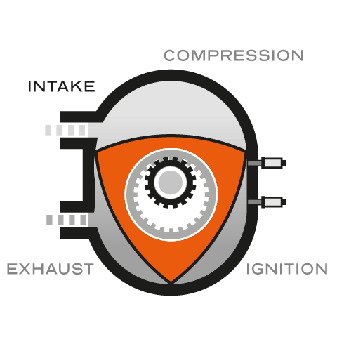
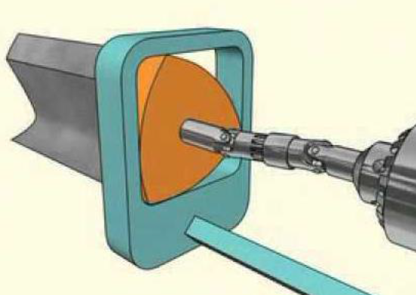
I built a coffee-table which fits exactly between the wall and the sofa, no matter which way round I turn it.
What shape could it be?
I have a coin of constant width
(but it isn’t a circle either)
There is a type of drill bit that
can drill square holes (nearly)

Slide 2
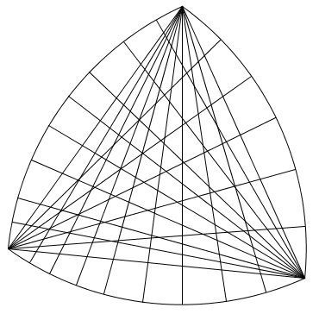
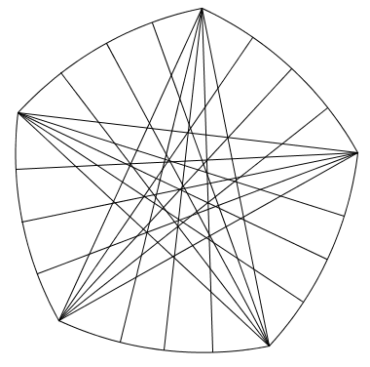
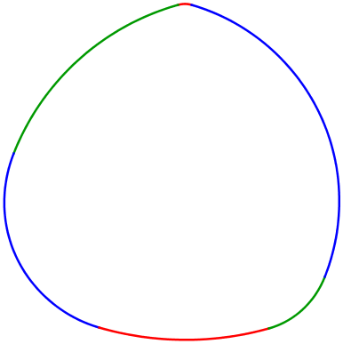

Slide 3
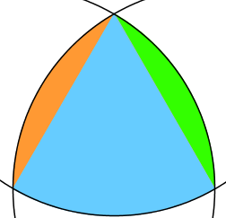
What is the circumference of a Reuleaux triangle with diameter $10cm$ ?
(consider the angle and radius of each arc)
$$3×\left(\frac{60}{360}×2×π×10\right)=10π$$
$$Sector=\frac{50π}{3}$$
What is the area?
Hint: Find the area of the blue sector first, then the equilateral triangle then the segments left over.
$$Triangle=25\sqrt{3}$$
$$Segment=\frac{50π}{3}−25\sqrt{3}$$
Half a circle , minus two triangles: $A=50π−50\sqrt{3}$

