Slide 1
What does ‘random’ mean?
No known pattern / unpredictable
We can’t predict the result of a random event.
But that doesn’t mean we know nothing about random events.
For instance:
Equivalent outcomes are equally likely
Fair dice have 6 faces. Each number is equally likely.
And that means that, for 6000 rolls, we should expect around $1000$ of each.
(in fact, it turns out there is a 99% chance of getting between 950 and 1050)
This sort of prediction is used for gambling, but also by businesses, governments, or anywhere where there is randomness or uncertainty.

Slide 2
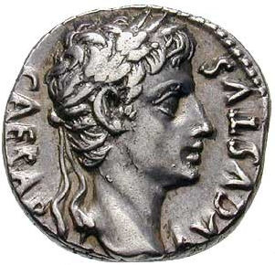
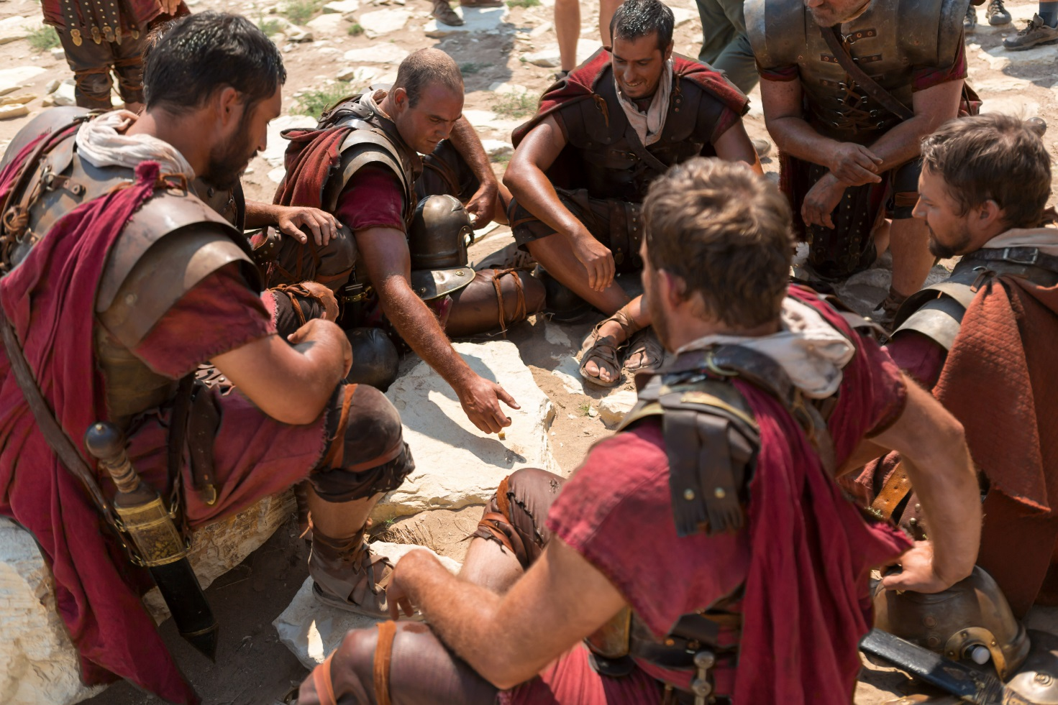
Probability
The mystery of the unknowable
You won the coin toss - Caesar has spoken! We’ll do it your way.
“The will of the gods”
“Fate”
“Destiny”
“Luck”
“Fortune”
“Providence”

Slide 3
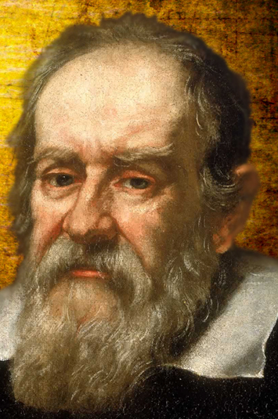
Probability
The science of randomness
“Mathematics is the alphabet with which God has written the universe.” Galileo, 1564-1642
The chance of something happening can be described in words:
Impossible, Very Unlikely, Unlikely, Even, Likely, Very Likely, Certain
Choosing numbers instead lets us compare two events more precisely,
and even make predictions about them.
$$Impossible=0 Even=\frac{1}{2} Certain=1$$
‘$Unlikely$’ $<\frac{1}{2}$ ‘$Likely$’ $>\frac{1}{2}$

Slide 4
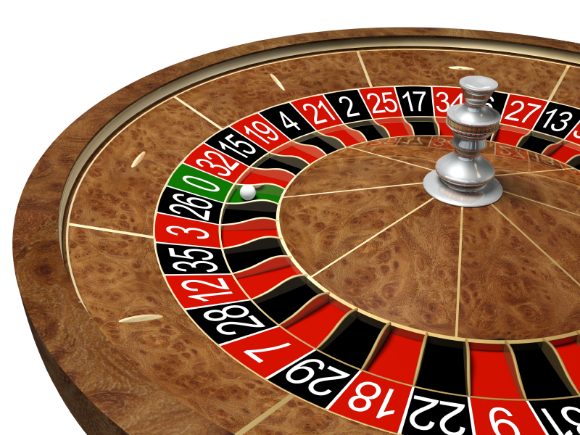
On one occasion, in a Monte Carlo casino, a roulette wheel came up black 20 times in a row.
Would you bet red or black for the next throw?
Why?
Throw 21:
Throw 22:
Throw 23:
Throw 24:
Throw 25:
Throw 26:
Throw 27:
Throw 28:
Throw 29:
Throw 30:
Black
Black
Black
Black
Black
Black
Red
Red
Black
Red
Notes:
On August 8th in 1913, the roulette wheel showed up black 26 times in a row. Some bet on black assuming the streak would continue (and lost big when it eventually stopped), and many bet on red, assuming the streak was almost certain to end soon (and lost big before red ever came). If you followed a martingale strategy, doubling your bet every time you lost, 26 losses in a row would mean you’d need a bank roll of over half a billion to cover an initial £10 bet (plus, you’d only come out with a £10 profit).

Slide 5
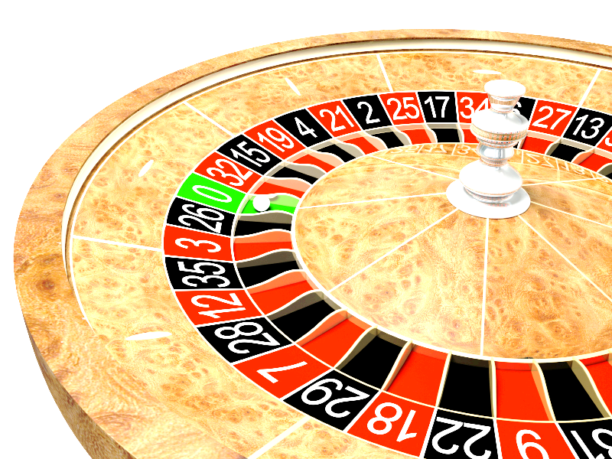
The Gambler’s Fallacy
A commonly held (if often subconscious)
Belief that is the result of a logical error.
If you keep playing whether you’re winning or losing, what is the only thing that will make you stop?
“I’m losing, so I need to keep playing – sooner or later I’ll start to win, then I can recover my losses”
“I’m winning, so I need to keep playing – I’ve hit my streak; I can’t stop now.”

Slide 6
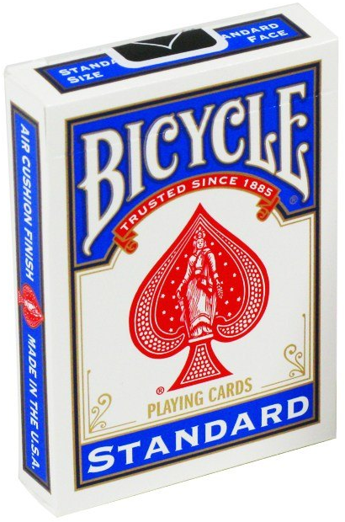
Win A Pack of Cards
I will toss a coin 10 times.
Each person will guess the outcome of each throw:
Put your hand up high to predict ‘Heads’
Leave your hands down to predict ‘Tails’
If you are wrong, even once, sit down – you are out of the game.
If you guess all 10 coin tosses correctly, you win the cards.
What is the chance of winning this game?

Slide 7
Probability Challenge
Imagine you toss a coin 20 times. Write down a list of H’s and T’s to represent what you might expect to get. Make it look as realistic as possible!
Actually toss a coin 20 times and write down the outcome of the throws in order.
I will look at your two sets of results and try to guess which one is genuine and which one you made up.

Slide 8
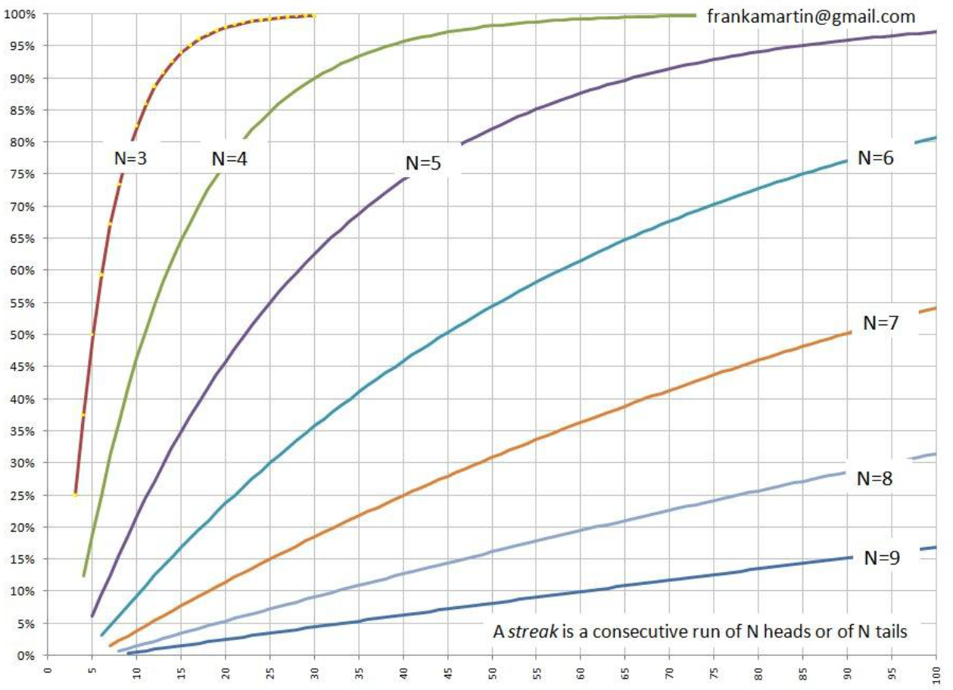
There is a 45% chance of getting a run of 5 heads or tails when you toss a coin 20 times

Slide 9
The Science of Randomness
1. How old is the study of probability?
2. How do we use numbers to describe chance?
3. What do we mean by ‘random’?
4. Why is an ipod ‘random shuffle’ not random?
Crunching the Numbers
1. What’s the chance of not getting three
identical coin tosses in a row?
2. What is the ‘pigeonhole principle’?
3. What is the chance of two people in
Bingham sharing a pin number?
4. What is the chance of a Royal Flush
when you draw 5 cards?
The Art of Gambling
1. How far back does gambling go?
2. What is the ‘Gambler’s Fallacy’?
3. What’s the problem with a ‘Martingale system’?
4. Why do bookies love accumulator bets?
Notes:
Notes for students to have in front of them during this lesson

