Slide 1
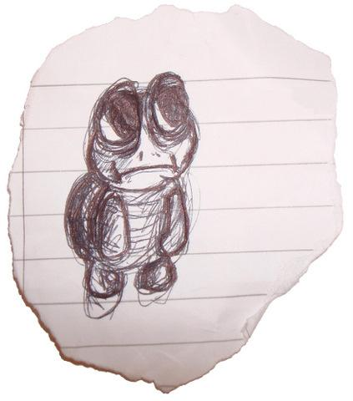
Without thinking too hard about it, guess where on this
number-line from one to a million the number 1000 belongs.
Right now we don’t care about logical, mathematical reasoning – we want to test our natural instincts, to try to find out something about how our brains perceive numbers.
In what universe is a thousand halfway to a million??
(This is the actual position of 1000)
Which of these arrows is closest to your original guess?

Slide 2
Which two people are closest in income?
£1k
£120k
$$+£9k$$
$$+£90k$$
$$+£20k$$
$$+£1.08m$$
£10k
£100k
£1.2m
A B C D E
Agree or disagree?
So how should we
answer “How much richer?” questions?
B is much better off than A.
C is much better off than B.
D is much better off than C.
E is much better off than D.

Slide 3
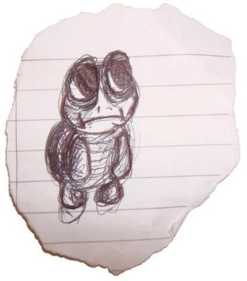
£1k
£120k
$$×10$$
$$×10$$
$$×1.2$$
$$×10$$
£10k
£100k
£1.2m
What is this weird scale we naturally prefer?
How can going down from 2 cigarettes to 1 be harder than from 20 to 19?
In what universe is having a 6th kid less of a big deal than having a 2nd?
How is a 10th friend joining a party less noteworthy than the 3rd one?
Who drives 10 minutes to save £5 off a £15 item, but not a £50 one?
Whoa!
It’s this universe…

Slide 4
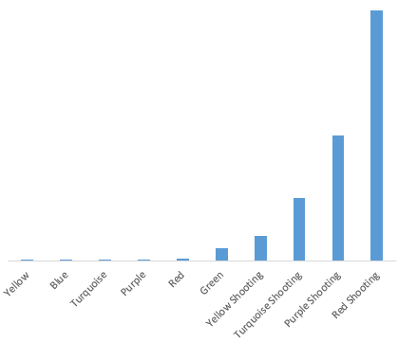
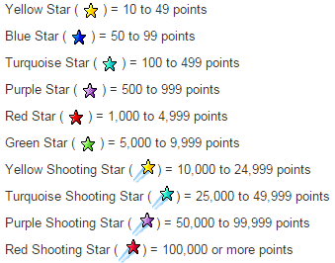
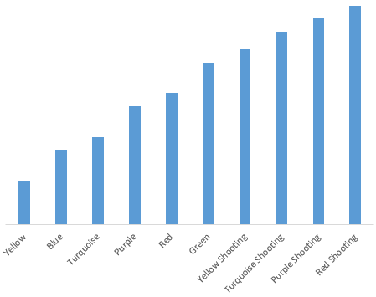
eBay follows a multiplicative system for awarding stars
Stars are awarded to eBay members for achieving 10 or more feedback points.
Here’s what the different stars mean:
The length of a number is the number of digits it has.
Number of Sales
Length of number of Sales

Slide 5
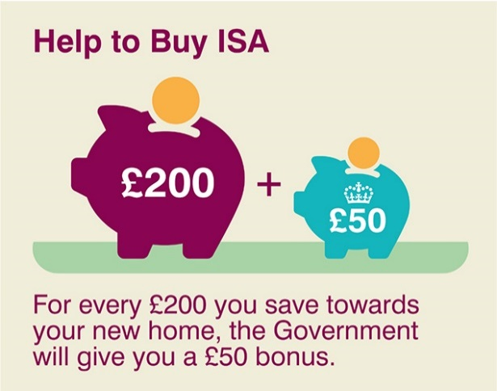
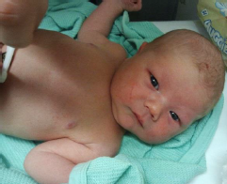
We are using this ‘multiplicative scale’ whenever:
We talk about ‘growth rate’ rather than ‘growth’:
We use proportion, relating a value to the original:
(eg %, or “save … when you spend …”)
We describe the age of a person
Last year, Fiji’s population grew by 7,000,
while the UK’s population grew by 384,000.
(That’s 0.8%)
(That’s 0.6%)
A new-born is “3 hours old”, then turns into a “2 week old” before graduating to “3 months”, “6 months”, “1 and a half”, and eventually to just whole years, then “late 20s”, and finally “in his 40s”, etc.

Slide 6
Power ratio
of the sound
$$×10000$$
Is a conversation 100 times louder than a fridge?
Is a motorbike 1000 times louder than a vacuum cleaner?
Is a shotgun 10,000 times louder than a chainsaw?
$$×1000$$
$$×100$$
The Decibel scale mirrors our interpretation of the relative volume of different sounds.
$$×10$$

Slide 7
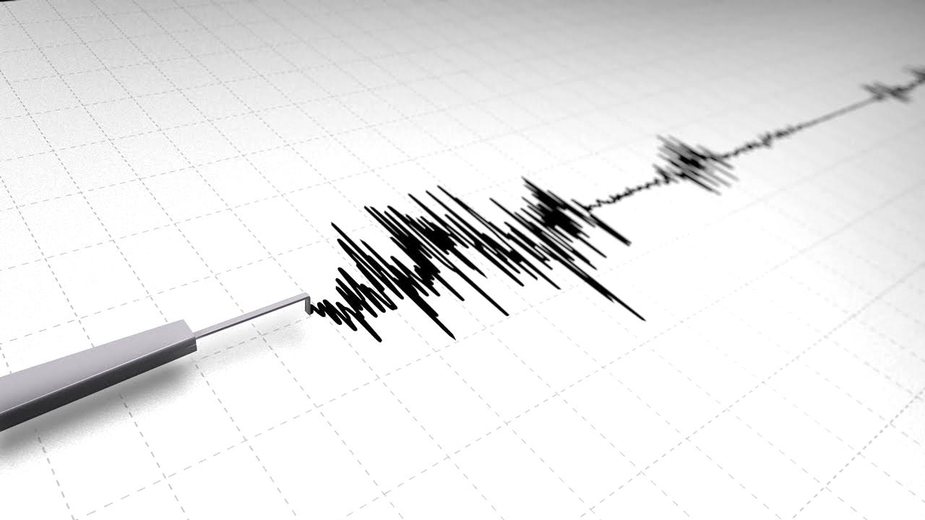
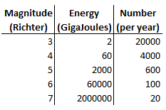
The Richter Scale for earthquakes
A size 3 is barely detectable.
A size 4 has 30 times more energy, but is only slightly worse.
The energy grows faster than the actual impact.
These numbers are changing so fast it makes more sense to count the digits…

Slide 8
On an additive scale, 0 is the pivot
(opposites go either side, distance is defined as how many steps away)
On a multiplicative scale, 1 is the pivot
(opposites are reciprocals, and distance is how many multiplications away)
On this multiplicative scale, what is:
$${81}^{\frac{1}{2}}=9$$
Half of 81 (halfway from 1 to 81)?
Two lots of 3 (twice as far from 1)?
Two-thirds of 27 (two-thirds of the way from 1)?
The opposite of 243 (same distance from 1, but to the left)?
$$3^{2}=9$$
$${27}^{\frac{2}{3}}=9$$
$${243}^{−1}=\frac{1}{243}$$

Slide 9
$\log_{10}{1000}$ means the number of steps (of size $×10$) from 1 to $1000$.
$$\log_{10}{1000}=3$$
Base Logarithm*
$${10}^{3}=1000$$
$${WhatPowerDoes}_{10Need}{ToBecome1000}=?$$
*aka power, index, order, exponent

Slide 10
$\log_{3}{81}$ means the number of steps (of size $×3$) from 1 to $81$.
$$\log_{3}{81}=4$$
Base Logarithm*
$$3^{4}=81$$
$${WhatPowerDoes}_{3Need}{ToBecome81}=?$$
*aka power, index, order, exponent

Slide 11
How big are the following numbers in $×4$ counting?
In other words, how many times must you $×4$ from $1$ to reach them?
1) $16$
2) $64$
3) $4$
4) $1$
5) $\frac{1}{4}$
6) $2$
7) $\sqrt{2}$
8) $32$
9) $0$
10) $−4$

Slide 12
How big are the following numbers in $×4$ counting?
In other words, how many times must you $×4$ from $1$ to reach them?
6) $2$ $\log_{4}{2}=\log_{4}{4^{\frac{1}{2}}}=\frac{1}{2}$
7) $\sqrt{2}$ $\log_{4}{\sqrt{2}}=\log_{4}{4^{\frac{1}{4}}}=\frac{1}{4}$
8) $32$ $\log_{4}{32}=\log_{4}{4^{\frac{5}{2}}}=\frac{5}{2}$
9) $0$ $\log_{4}{0}$ not possible
10) $−4$ $\log_{4}{−4}$ not possible
1) $16$ $\log_{4}{16}=\log_{4}{4^{2}}=2$
2) $64$ $\log_{4}{64}=\log_{4}{4^{3}}=3$
3) $4$ $\log_{4}{4}=\log_{4}{4^{1}}=1$
4) $1$ $\log_{4}{1}=\log_{4}{4^{0}}=0$
5) $\frac{1}{4}$ $\log_{4}{\frac{1}{4}}=\log_{4}{4^{−1}}=−1$

Slide 13
Doing calculations with ‘length of number’
Think of $\log_{10}{x}$ as simply “how long is $x$ in decimal?”
$\log_{2}{x}$ is just “how long is $x$ in binary?”, etc…
Roughly speaking, what would you expect when you:
1. Multiply a 3 digit number by a 4 digit number?
$length\left(xy\right)=length\left(x\right)+length\left(y\right)$: $\log_{10}{xy}=\log_{10}{x}+\log_{10}{y}$
2. Divide a 7 digit number by a 5 digit number?
$length\left(\frac{x}{y}\right)=length\left(x\right)−length\left(y\right)$: $\log_{10}{\frac{x}{y}}=\log_{10}{x}−\log_{10}{y}$
3. Raise a 3 digit number to the power 4?
$length\left(x^{n}\right)=n×length\left(x\right)$: $\log_{10}{x^{n}}=n\log_{10}{x}$
A 7 digit number
A 2 digit number
A 12 digit number

Slide 14
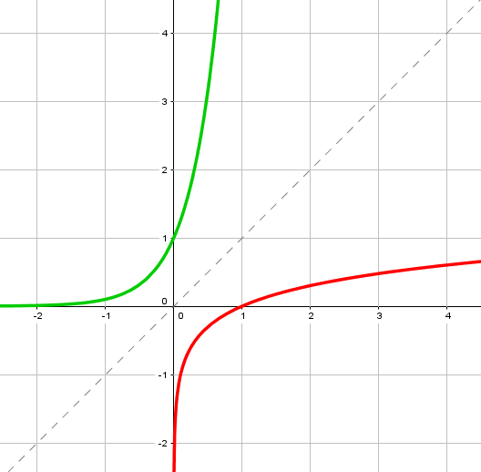
The logarithmic function is the inverse of the exponential function
While the exponential function increases at an ever-increasing rate, the logarithmic function increases at an ever-decreasing rate.
$$y={10}^{x}$$
$$y=x$$
If ${10}^{x}$ converts a number like 9 to 1,000,000,000, then $\log_{10}{ }$ must need billions just to produce a 2-digit answer…
$$y=\log_{10}{x}$$

Slide 15
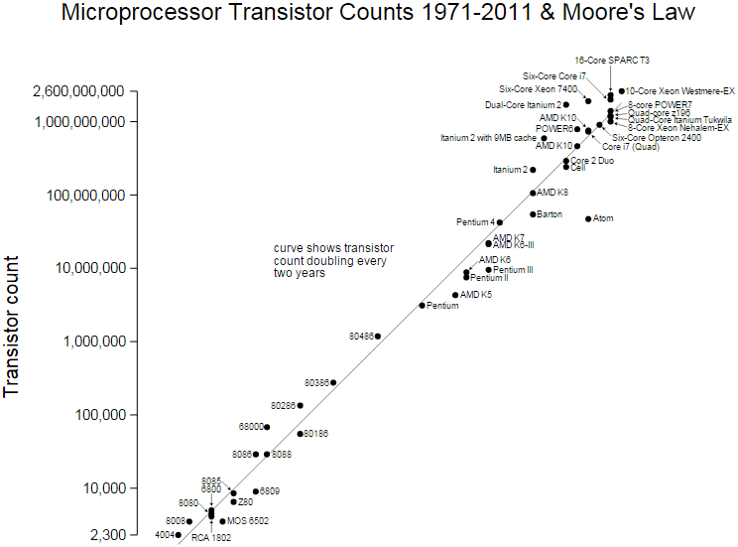
Moore’s law recognises the fact that
computing power doubles roughly every 2 years.
What’s up with the scale on that graph?

Slide 16
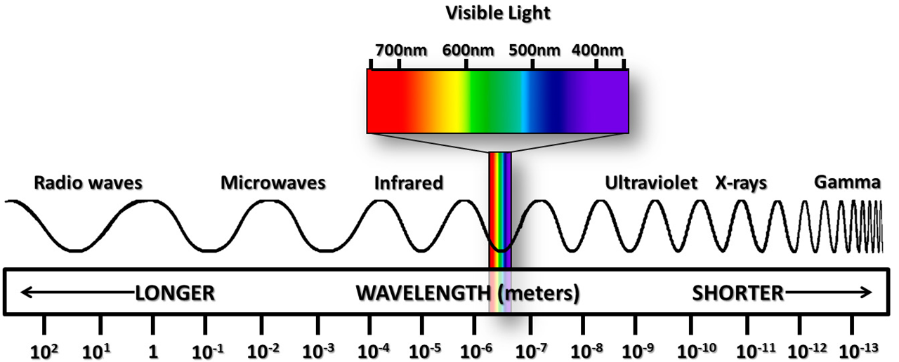
It’s another log scale! Come to think of it, don’t we use standard form all the time?

Slide 17
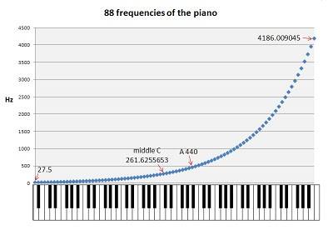
So I have to double the frequency every time I go up an octave?

Slide 18
