Slide 1
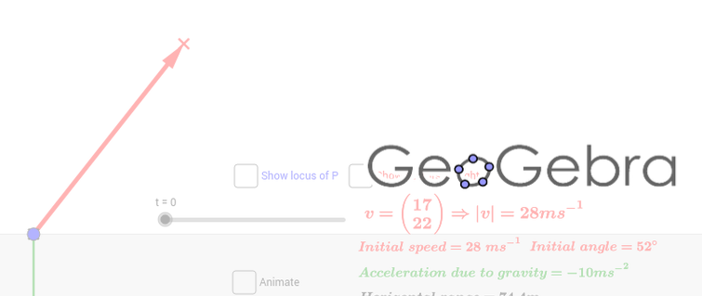

Slide 2
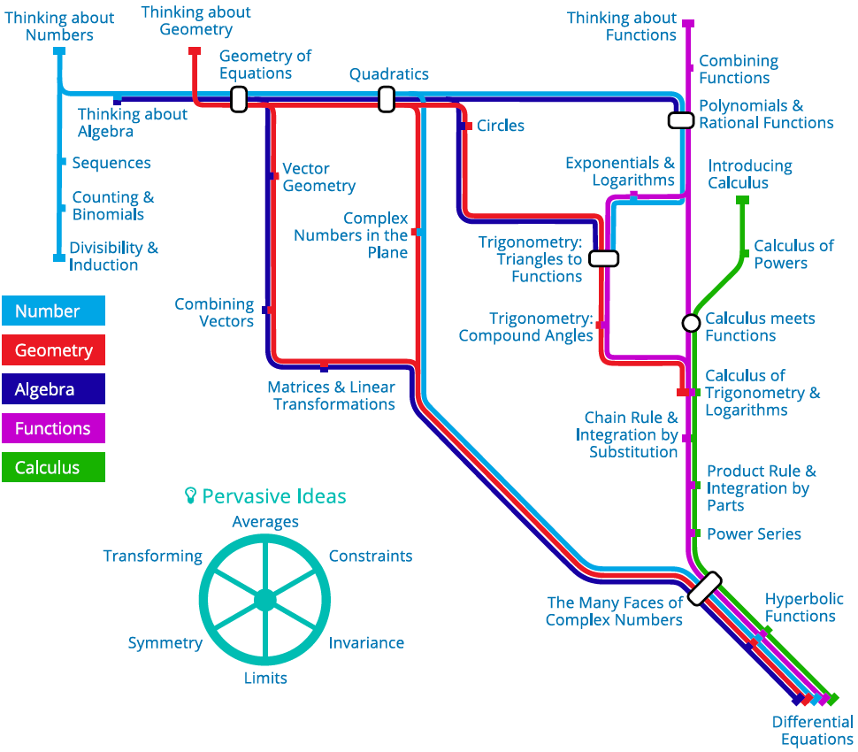

Slide 3
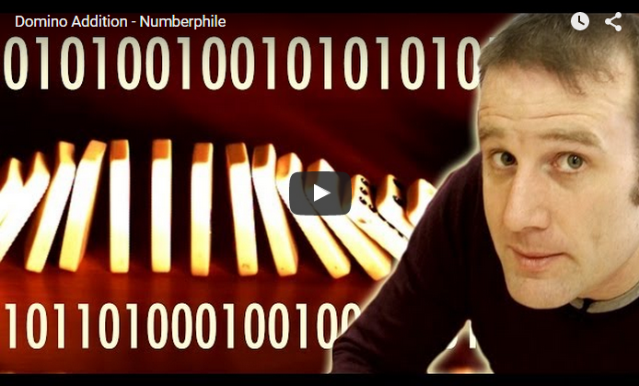
Numberphile

Slide 4
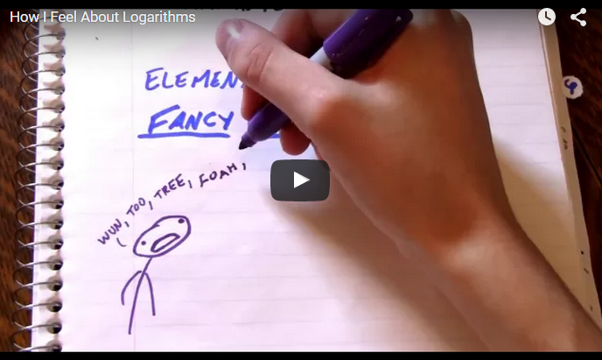
ViHart

Slide 5
Veritasium

Slide 6
Vsauce

Slide 7
XKCD
What If

