Slide 1
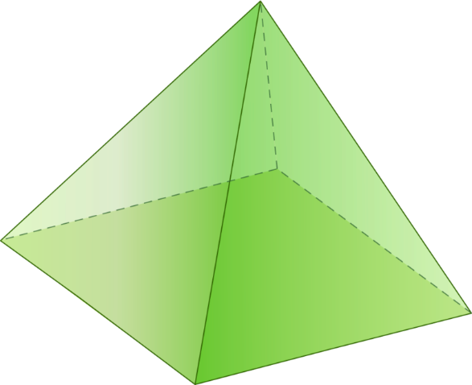
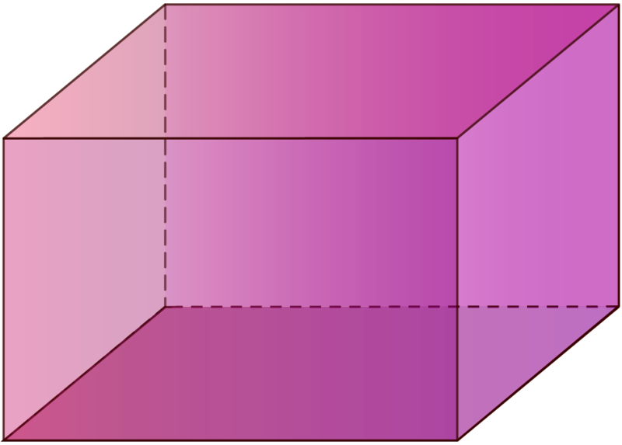
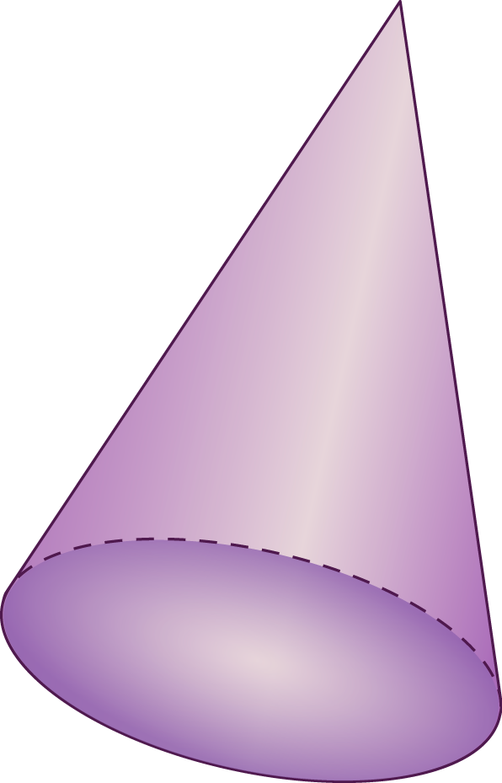
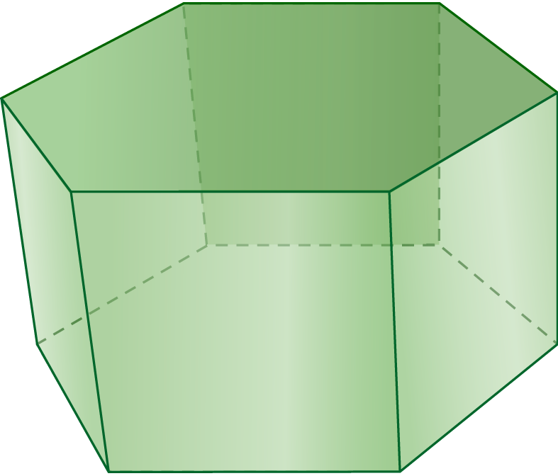
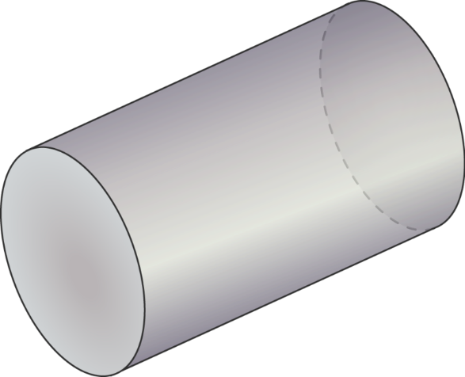
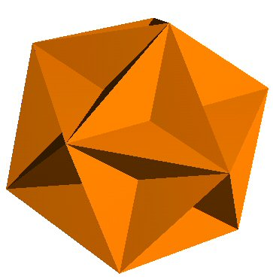
3D Shapes

Slide 2
Volume
Cuboid
$$V=length×width×height$$
(rectangular prism)
Prism
$V=cross$-$sectional area×length$

Slide 3
Volume
Prism
$V=cross$-$sectional area×l$
Cylinder
$$V=πr^{2}h$$
(circular prism)

Slide 4
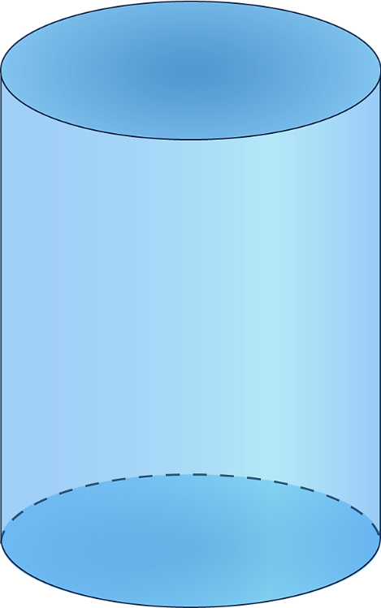
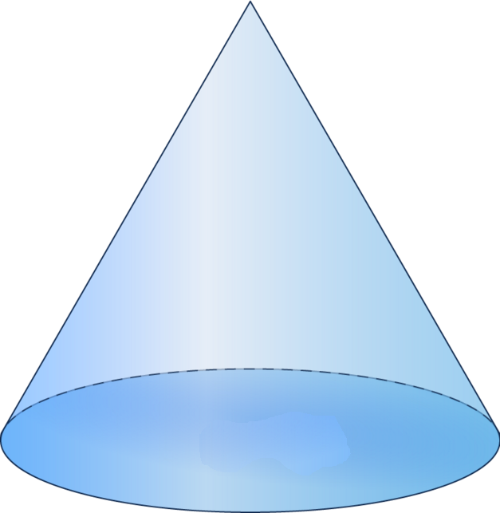
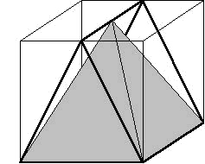
In 2 dimensions, a triangle takes up exactly $\frac{1}{2}$ of the enclosing rectangle
In 3 dimensions, a cone takes up exactly $\frac{1}{3}$ of the enclosing cylinder
In fact, any pyramid takes up exactly $\frac{1}{3}$ of the enclosing prism

Slide 5
Volume
Cylinder
$$V=πr^{2}h$$
$$V=\frac{1}{3}πr^{2}h$$
Cone
$\left(\frac{1}{3} of a cylinder\right)$
$$V=\frac{1}{3}×base area×h$$
Pyramid
$\left(\frac{1}{3} of a prism\right)$

Slide 6
Volume
$$V=\frac{4}{3}πr^{3}$$
Sphere

Slide 7
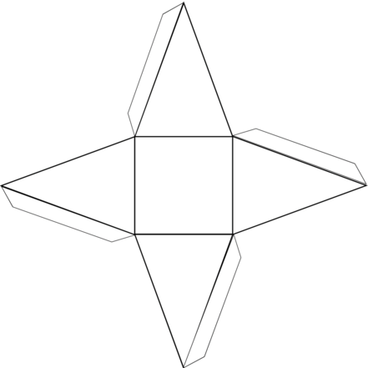
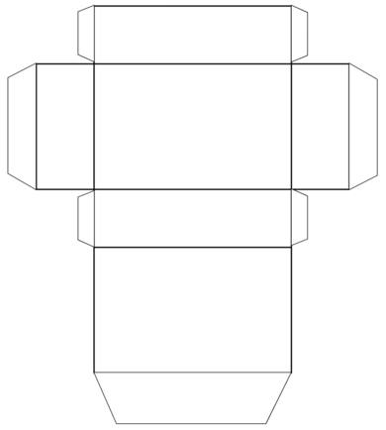
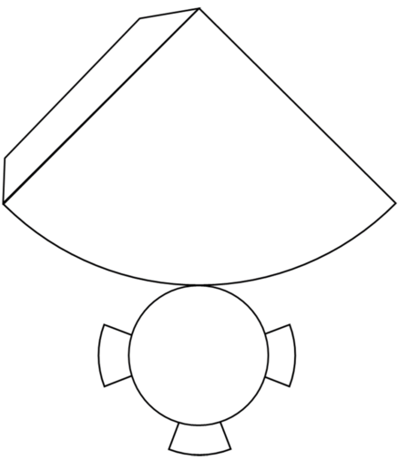
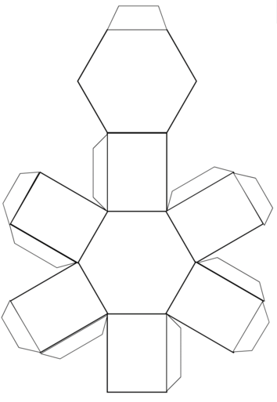
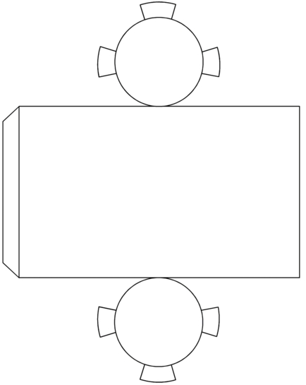
Nets

Slide 8
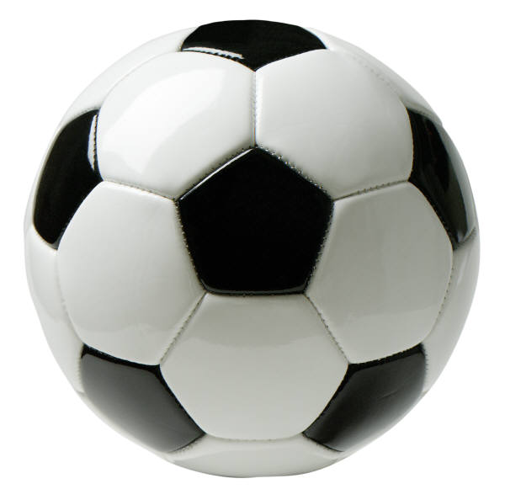
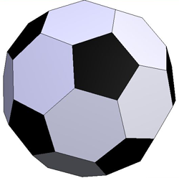
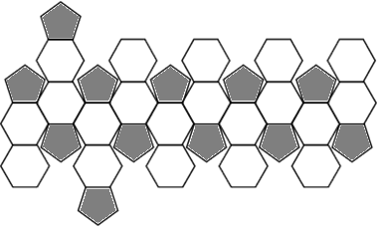
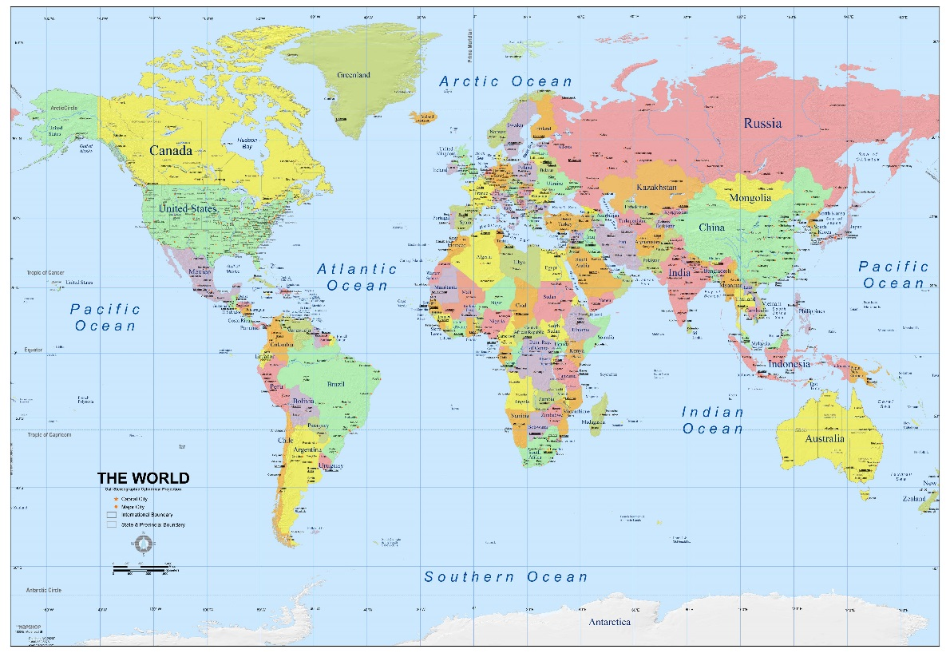
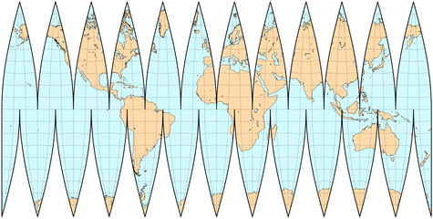
Nets
?

Slide 9
Surface Area
Area of all rectangles
Area of the base, top and rectangles
Area of the base and the triangles

Slide 10
Surface Area
$$SA=2πr^{2}+2πrh$$
$$SA=4πr^{2}$$
$$SA=πr^{2}+πrl$$
Note: $l=$slant height
For height $h$ and radius $r$:
$$l=\sqrt{h^{2}+r^{2}}$$

